Slide 1
Financial Aid & Scholarships
Class of 2024
Presented by College and Career Team

Slide 2
Agenda
Financial Aid Overview/ Types of Aid
Florida Financial Aid Application (Bright Futures)
Florida Financial Aid Application Steps
FAFSA/ FSA ID
CSS Profile Overview

Slide 3
Financial Aid Options
Federal Aid
Fafsa.gov
Grants, Work Study, Loans (last resort--only if needed)
State Aid
https://www.floridastudentfinancialaidsg.org/
Over 11 scholarships including the Bright Futures Scholarship
Institutional Aid
Scholarships and grants from a college/university
Check financial aid websites of the colleges/universities you are applying to
CSS Profile (select private institutions)
Private Scholarships
Financial aid awards funded by companies, service groups, foundations, organizations, individuals
Search on Naviance

Slide 4
Bright Futures Information
Application is now open!
Application must be completed during senior year.
Qualifying test scores must be achieved no later than the July 2024 test date.
Send official test scores to at least 1 Florida public university for Bright Futures to receive it.
Do not send ACT Superscore- Send individual scores.
Can reinstate award up to 5 years after graduation.

Slide 5
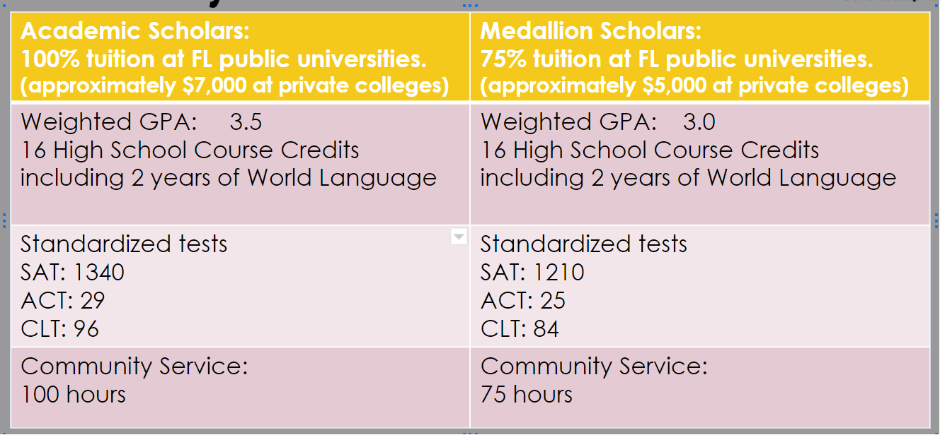
Bright Futures Requirements

Slide 6
Bright Futures Requirements
4 English Credits
4 Math Credits
3 Natural Science Credits
3 Social Science Credits
2 Foreign Language (same language)
16 credits (will take credits with the highest grades)
Honors weighted .5 extra & AP/ DE weighted at 1.0 extra
https://sso.osfaffelp.org/BFIEHS/Course/ComprehensiveCourse

Slide 7
Bright Futures Requirements
Be a Florida resident
Be a U.S. citizen or eligible noncitizen.
Enroll as a degree- or certificate-seeking student at a Florida institution in at least 6 non-remedial semester credit hours. Summer semester counts too!
FMS will cover 100% tuition if attending a 2 year college (Valencia, Seminole, Santa Fe, etc.).

Slide 8
Bright Futures Requirements
In the Spring, check your Financial Aid Recipient History (FARH) for eligibility status.
In May, update your attending college.
Renewal requirements while in college
Florida Academic Scholars- 3.0
Florida Medallion Scholars- 2.75
The Florida Legislature reserves the right to change the value/ requirements of this program at any time!

Slide 9
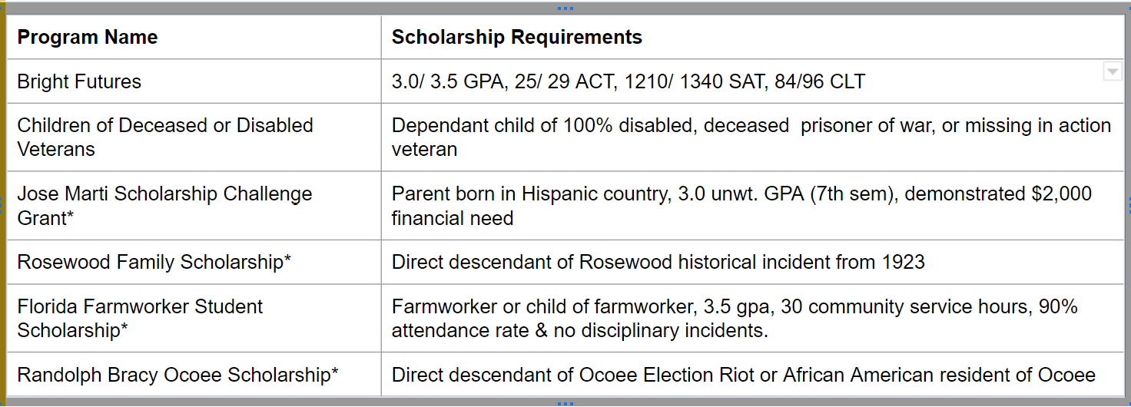
FL Scholarships Requiring a Florida Financial Aid Application (FFAA)
* Must submit FAFSA to be considered for the scholarship

Slide 10
FAFSA (Free Application for Federal Student Aid)
FAFSA is being revised and will open in December.
Apply early! Check priority aid deadlines for each college.
Work with your parent(s) to complete. Will need tax/ financial information.
Even if you don’t qualify for a Pell Grant, you can still be considered for financial aid/ scholarships through the college and federal loans.
If applying to more than 10 colleges, submit FAFSA, wait for it to process successfully, then add schools..

Slide 11
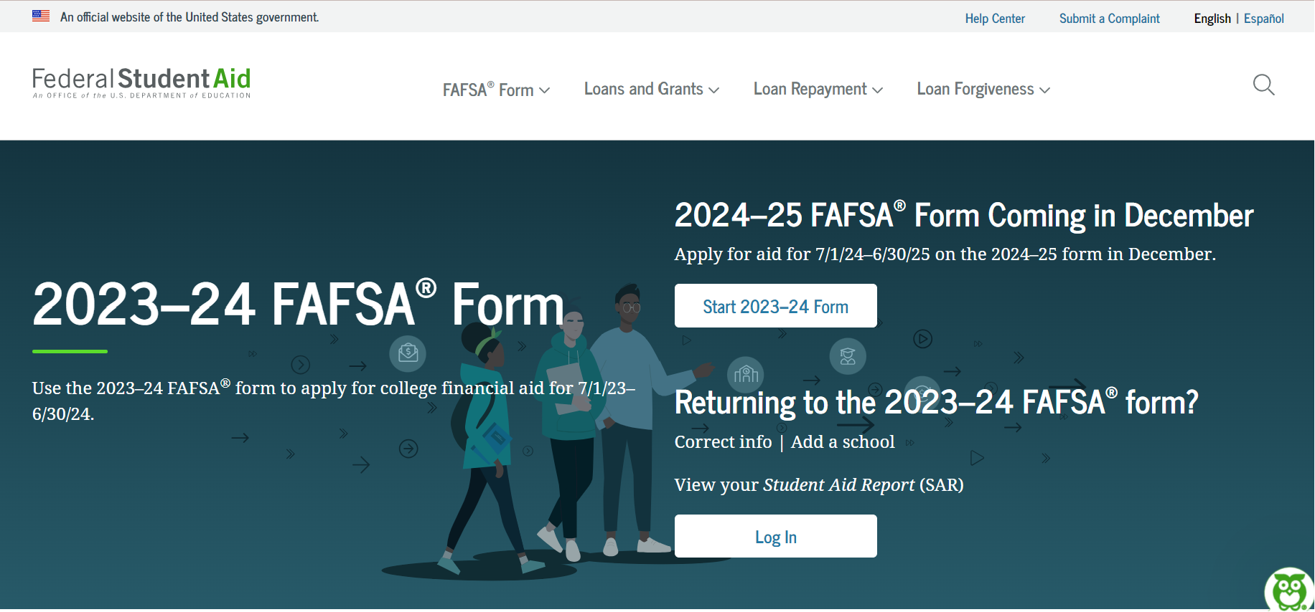
www.FAFSA.gov

Slide 12
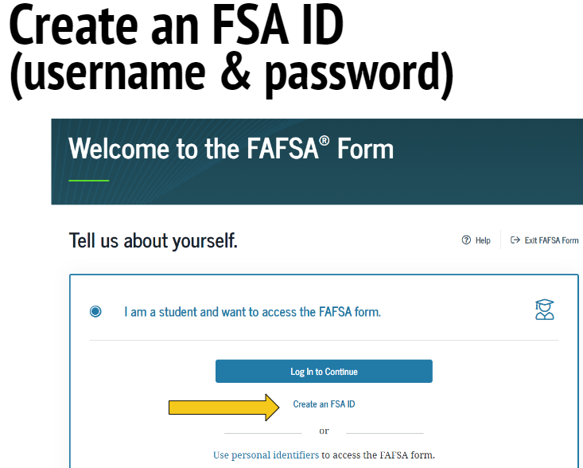
Create an FSA ID (username & password) now!

Slide 13
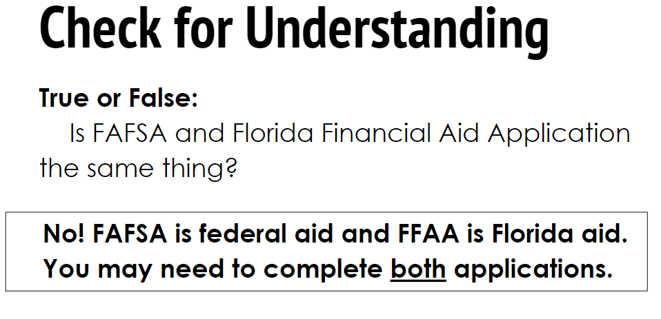
FAFSA vs. FFAA

Slide 14
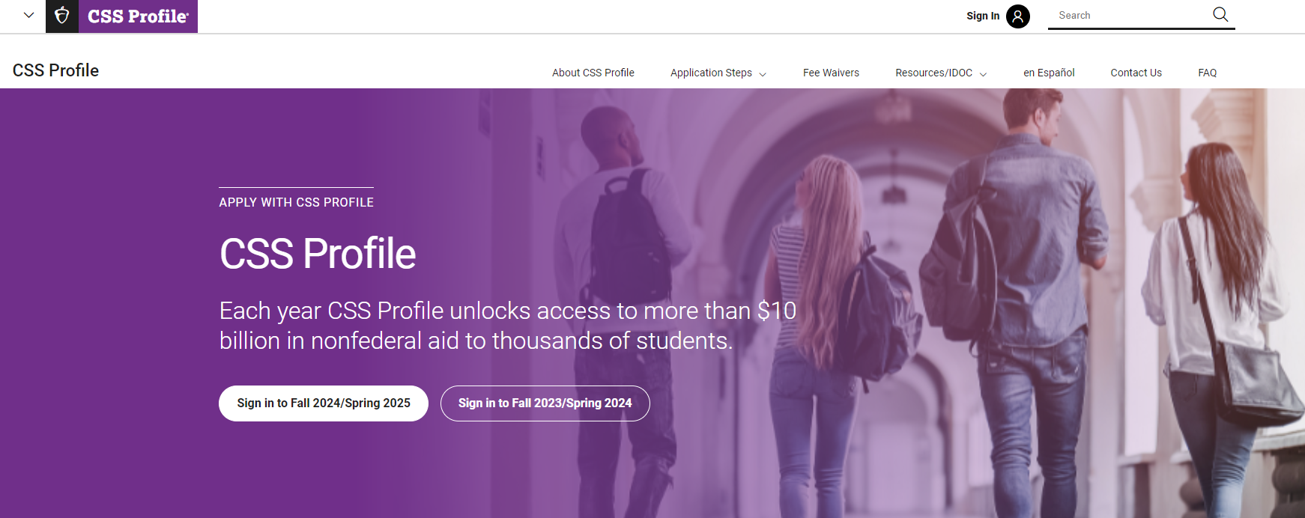
CSS Profile- College Board (only select private institutions)
**If your college requires the CSS Profile, you must complete it to receive institutional aid.

Slide 15
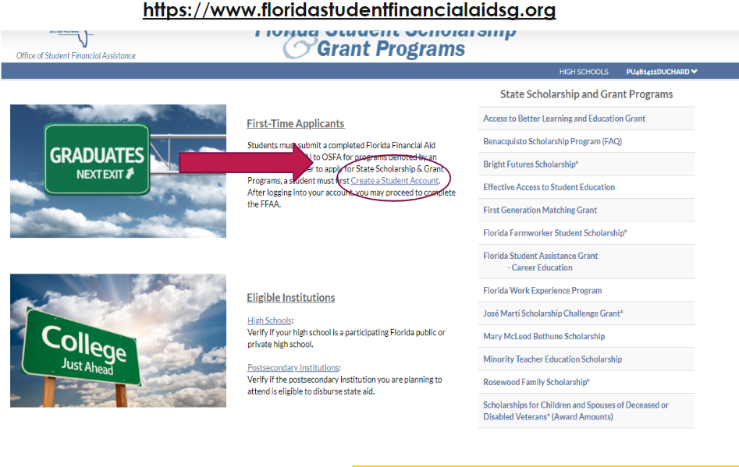
Create a Student Account

Slide 16
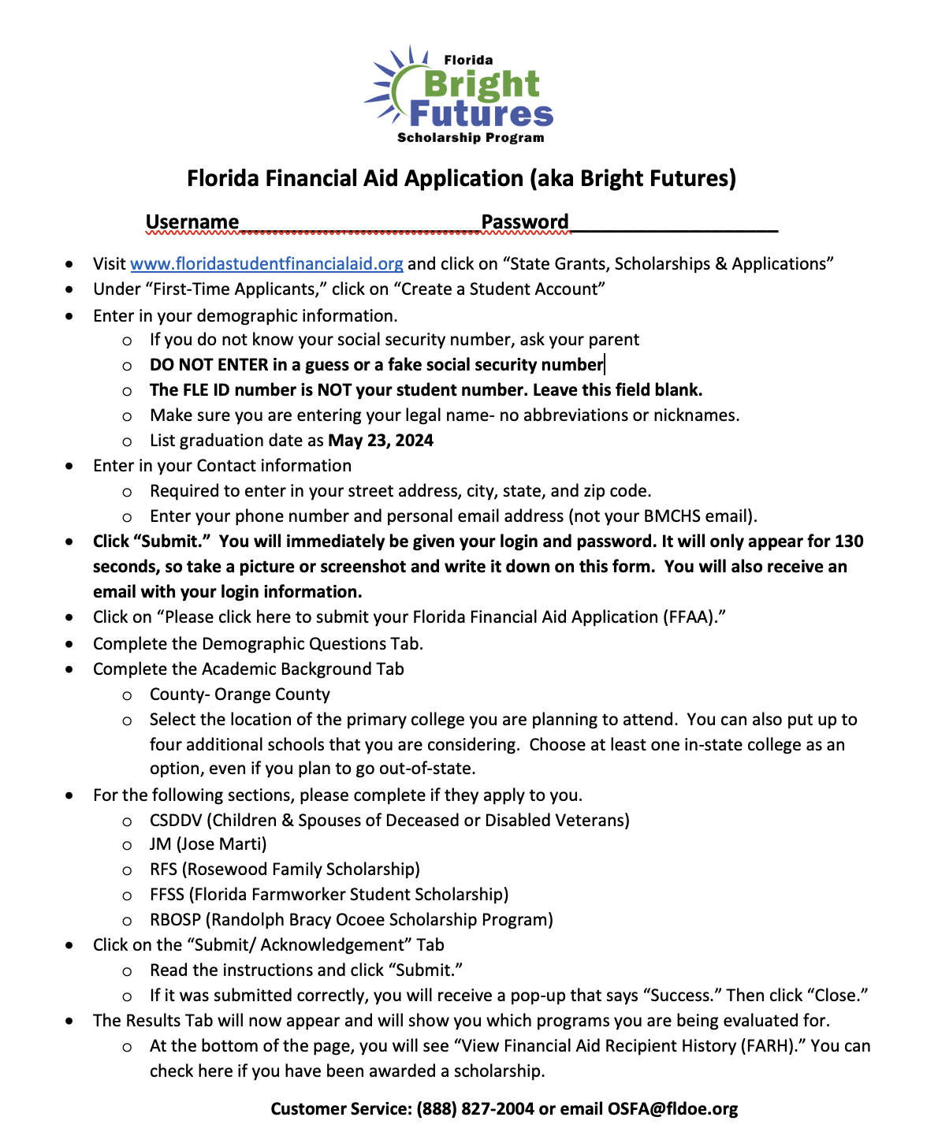
Bright Futures Aid Application Instructions
Instructions will be emailed home today (Wednesday).sr

Slide 17
If you have any questions,
please contact your
College and Career Counselor.
Go Hornets!

