Slide 1
Class of 2026
Rising Senior Parent Breakfast

Slide 2

Prayer
Notes:
Father, we pray for knowledge and understanding for all gathered here this evening. We pray that you will be with us as we journey together this school year. We pray for your wisdom and guidance as we work together to support our students. We ask this in Jesus’ Name. Amen.

Slide 3
Agenda
Introductions
Graduation Requirements
College Application Overview
College Trends
Staying Organized

Slide 4
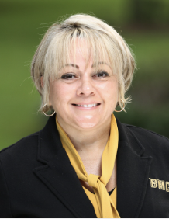
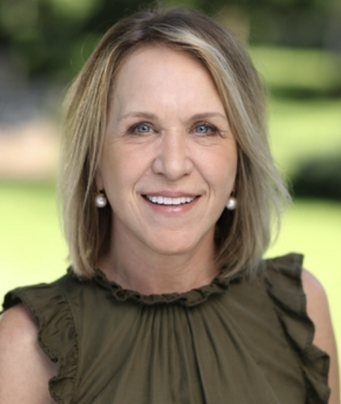
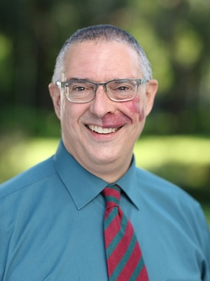
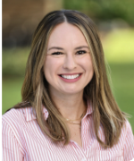
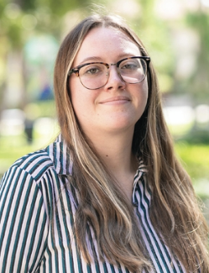
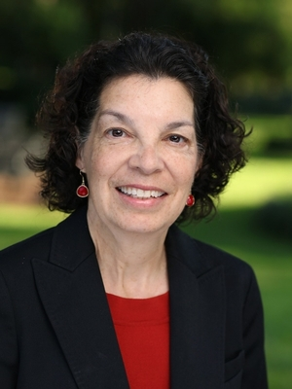
College and Career Team
Ms. Lugaro
Director of School Counseling and College & Career
Mrs. Etscorn
Assoc. Director of
College Outreach and Engagement
Mr. Hennes
College & Career Counselor
Mrs. Straw
College & Career Counselor
Ms. Cherry
College & Career Counselor
Mrs. Mazanec
College & Career Specialist
All students welcome 7:30-3:30 (lunches / 9th hour).
Students are assigned a college counselor in 10th grade.
Notes:
CCC-Anita

Slide 5

Graduation Requirements
To receive a Bishop Moore Catholic H. S. diploma, students must:
    Achieve a minimum cumulative GPA of 2.0.
    Earn 28 credits.
    Complete 25 hours of community service per year of attendance at BMC.
    Log community service hours electronically on the community service webpage.

Slide 6

College Apps and Common App
Presented by Kim Straw and Mackenzie Cherry

Slide 7

Preparation
Aim to apply to 4-8 colleges
  May add more if applying to extremely selective colleges (35% acceptance rate or less)
Expect to pay between $30-100 each application
Stay organized (login, requirements)

Slide 8
Keep an Eye on Deadlines!
Watch for deadlines- apply early!
  Early Action
  Early Decision (binding)
  Rolling
  Regular Decision

Slide 9

Institutional Application vs Common App
Institutional Applications - Done directly through the University’s application portal
  Two-year colleges (Valencia, Seminole State)
  Military Academies
  Other schools (California State Colleges, MIT, Georgetown, etc.)

Slide 10
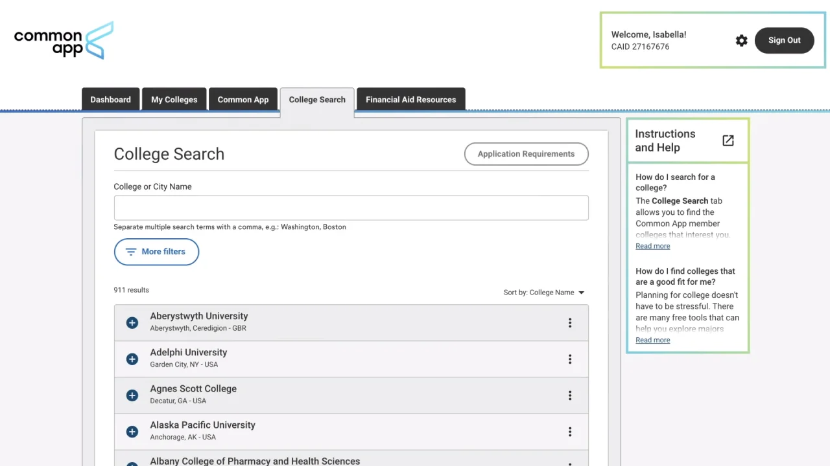
Institutional Application vs Common App
Common App- Apply for multiple schools with one application
  Highly recommended if applying to more than two colleges
  Over 1,100 colleges accept Common App

Slide 11

Common App
Streamlined application
General information that goes to each school
  Personal/family information
  Education information (classes, honors received, test scores)
  Activities
  Personal statement
  Letters of recommendation
Each school has a section to complete
  Institution-specific questions
  Supplemental writing
Students can submit to each school individually
when ready and pay application fee

Slide 12

Letters of Recommendation
Many colleges request for students to include a letter of recommendation from either a teacher, coach, or counselor.
  All teachers request at least two weeks notice for letters of recommendation.
  We recommend that they ask a teacher
from a core subject (math, science, English) from Junior year or a teacher they have had for multiple years.

Slide 13
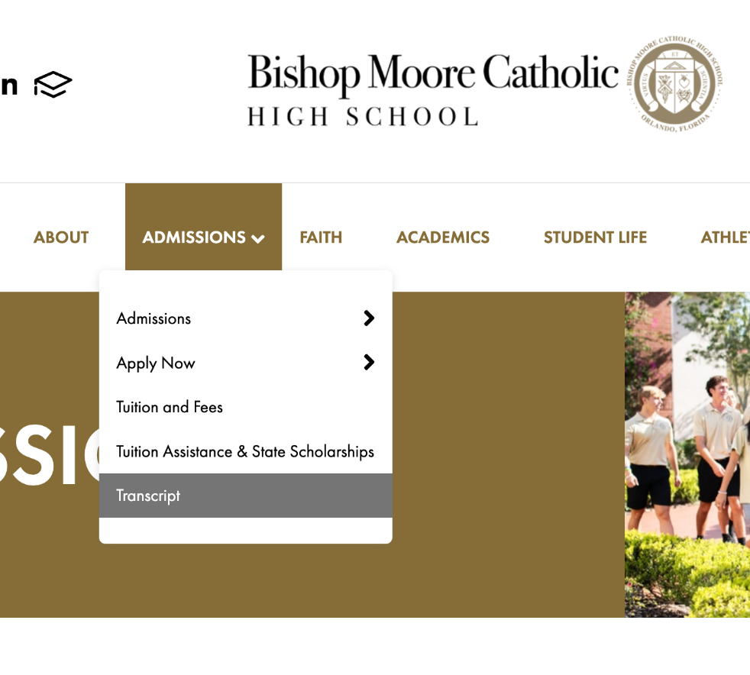
Transcripts
Each college needs high school transcript in some form
  Official transcript from Parchment
  SSAR (self-reported transcripts)
  SPARK (UCF specific form)
  Courses and Grades on Common App
Only the student can request an official
transcript or self-report their grades

Slide 14


Test Scores
Submit official test scores through College Board (SAT), ACT or CLT.
  Bishop Moore cannot send any scores on a student’s behalf.
Small number of schools allow self-reporting on portal.
Superscoring
  Use your best section-level scores, even if they are from different tests.
Sending your scores to a Public Florida University, will allow your scores to be submitted to Bright Futures.
If applying test optional- do not send test scores.

Slide 15

College Trends and Their Impact on Decisions

Slide 16
A Look At College Admissions Trends
Rise In Number Of Applications
Test Optional Admissions
Increase in Deferred & Waitlisted Students
Changing Admissions Rates

Slide 17
Reasons That College Admissions Are On The Rise
1. Increase in number of high school graduates
2. Ease of Common Application
3. Individual students are applying to more colleges
4. Test optional admissions

Slide 18
Predicting Yield As Applications Rise
What Is “Yield”?
Strategies colleges use to manage numbers:
* The addition of Early Decision & Early Action deadlines
* The creation of alternate pathways (spring/summer starts,
semester abroad, alternate campuses, direct connect)
* Switching from holistic approach to quantitative

Slide 19
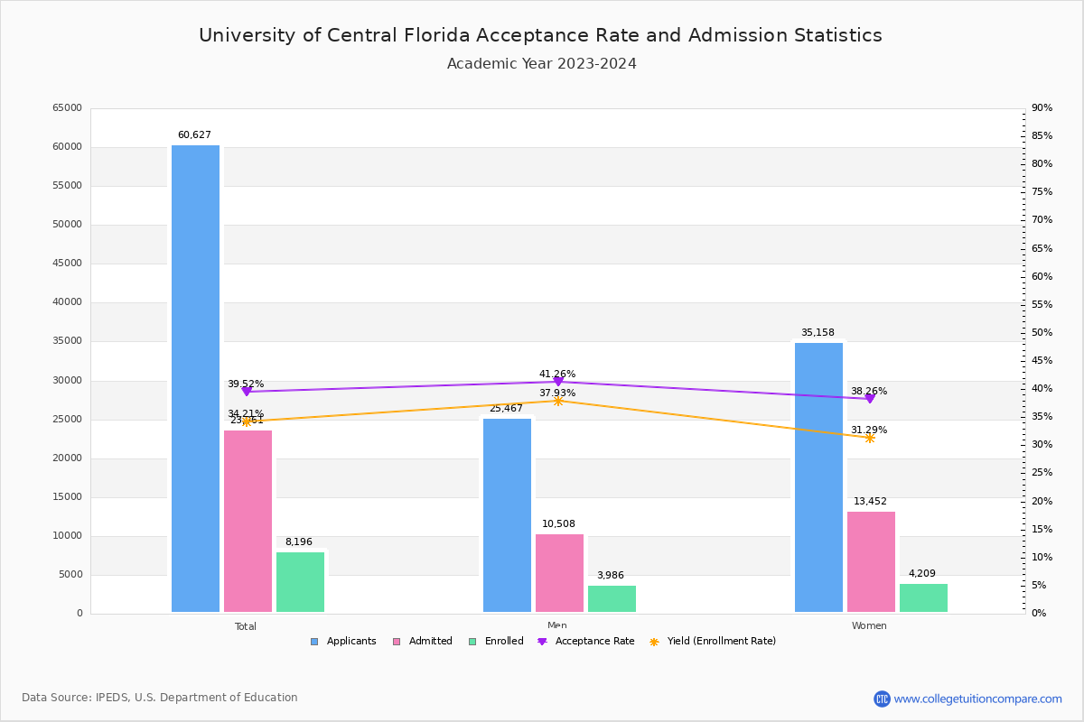

Slide 20
What Test Optional Really Means
Submit test scores if they positively reflect capabilities. (Scores should fall in or above the 50th percentile of the prior year’s accepted students’ scores.)
In true test optional admissions, colleges consider other aspects if there are no test scores (transcript, class rigor, extracurriculars, recommendations & supplemental essays-)
At highly selective colleges, tests scores carry weight!

Slide 21
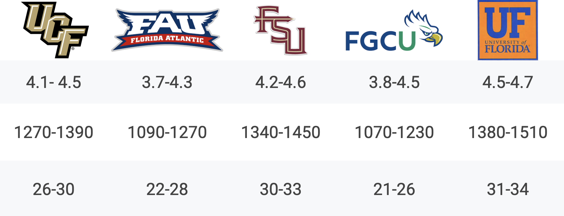

Slide 22
Deferrals & Wait Lists
Early admissions outcomes: admitted, denied, or deferred to Regular Admission
Students not admitted or denied under Regular Action may be offered a spot on the waitlist. (The Common Data Set provides information about how schools utilize their waitlists.)
Many schools are using deferrals and waitlists much more liberally than ever before.

Slide 23

The Change In Admissions Rates
Times have changed- so have admissions statistics!
Use current information provided in a college’s
“Freshman Profile” or in Naviance to
access information on prior years’ admissions.

Slide 24
Tips for Successful Admissions Outcomes
Do your research. Attend a college fair. Visit college campuses to get a true sense of a school and to demonstrate interest.
2. Keep an open mind and consider “fit” over rankings or reputations.
Seek out a few schools with higher admit rates that have special
programs in your student’s area of interest.
3. Build a BALANCED list based on your student’s unique credentials.
4. Quality applications and strong essays take time! Plan accordingly.
5. Trust that your student will end up- and thrive- exactly where they are meant to be!

Slide 25

Organization and Timelines
Presented by Eric Hennes

Slide 26
Big Picture Calendar
Spring/Summer
Resume
Testing
Visits
Gathering/Planning
Essays
Fall Semester
Applications
Testing (if applicable)
Recommendations
FAFSA
FFAA/Scholarships
Winter
Mid-Year Reports
Follow-up
Review Options
Spring Semester
Scholarships
Offers
Decisions
Deposits

Slide 27
Discussed in Spring - Due by August
Polished, uploaded resume to the Journal
Naviance
*Fillable worksheet
*Resume templates/samples

Slide 28
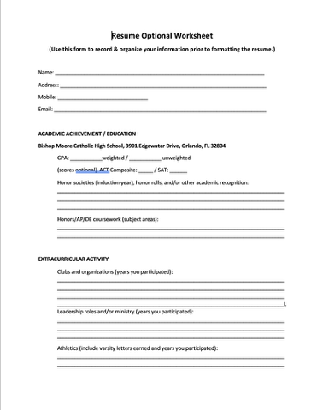
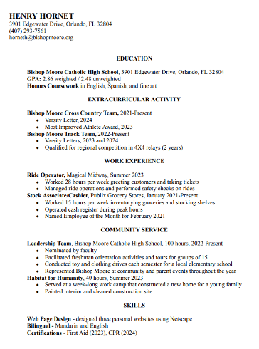
Staying Organized
Resource:
Naviance
> About me
> Document resources
> Resume/Recommendations

Slide 29
Discussed in Spring - Due by August
Balanced college list after visiting
Naviance
“College Comparison Worksheet”
“Colleges I’m Applying to” tab

Slide 30
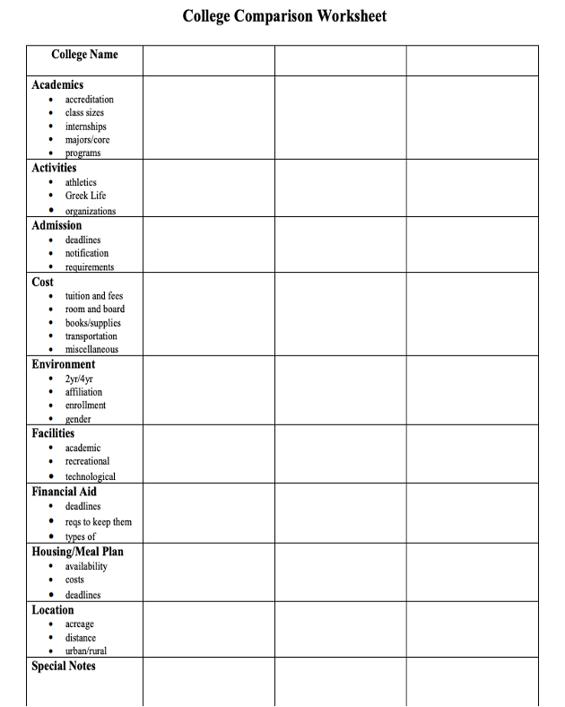
Staying Organized
Resource:
Naviance
> About me
> Document resources
> Application Process Tools

Slide 31
Discussed in Spring - Due by August
Identified application pieces/deadlines
Naviance
“My College Requirements Worksheet”
“College Application Checklist”

Slide 32
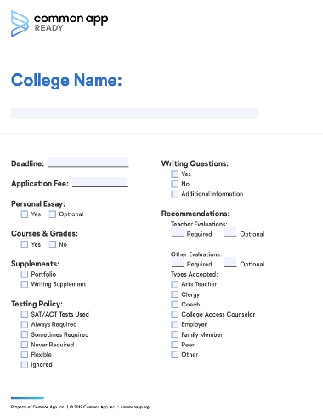
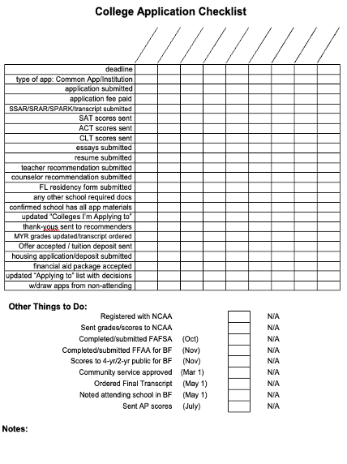
Staying Organized
Resource:
Naviance
> About me
> Document resources
> App. Process Tools

Slide 33
Planning Ahead Financially
1. FFAA (Bright Futures)
○November-December
○2 parts – online application & score submission
○Do it if you qualify!
2. FAFSA
○Create FSA ID as soon as possible
○Opens October 1
○Parental 2024 tax information
○Over summer, review site @ studentaid.gov

Slide 34
Planning Ahead Financially
3. Scholarships
○All year
○Each different
○Naviance, websites, institutions, BMC msgs
4. Include your student
○Ownership
○Learn fiscal responsibility
○“Financial Aid Comparison Worksheet”

Slide 35
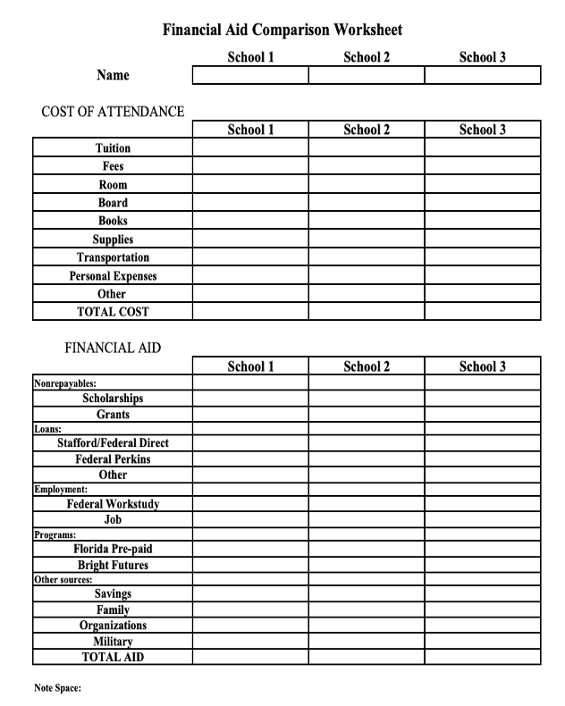
Staying Organized
Resource:
Naviance
> About me
> Document resources
> Application Process Tools

Slide 36
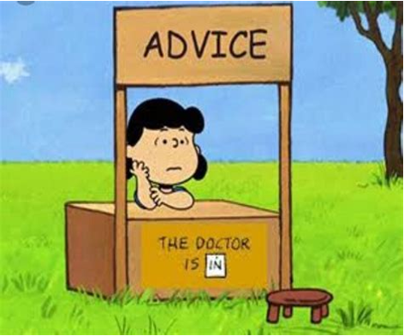
Help Students Stay Organized
●Empower but supervise.
●Add time - nothing’s automatic!
●Copy anything submitted.
●Manage time - it’s additional work.
●Monitor emotional expression.
●Ask for help.

Slide 37

Save the Date: Summer Workshop
When?
June 10th and 11th
What time?
9:00 - 11:00
Cost?
$150 per day or $300 for both days
An email with additional information will be sent next week.

Slide 38
Thank You!

