Slide 1
College Application Overview
Presented by Kristina Roberts, M.S. College & Career Counselor

Slide 2
Introductions
Introductions
If you attended college, what was your college application process like?

Slide 3
College Application Preparation
Explore majors
Research colleges and create interest list
Visit colleges in-person, at BMCHS, college fairs & online tours.
Create resume
Ask teachers for letters of recommendations
Plan meaningful summer activities
Meet with College & Career Counselor in Spring Junior year
Each student will have assigned College & Career Counselor starting Spring Junior Year
Notes:
.

Slide 4
Central Florida College Fair
Over 110 colleges attending!
When?
Saturday, February 25
Where?
University of Central Florida, Student Union
Time?
11am- 1:30 pm

Slide 5
Things to Consider When Building Your College List
In-state vs. out-of-state?
Public vs. private (cost)?
Mid-range GPA and test scores
Urban versus rural?
Selectivity rate
Size of student body
Availability of majors & programs
Social Life/ Campus Culture/Diversity
Special Needs

Slide 6
Balance Is Key
Target

Slide 7
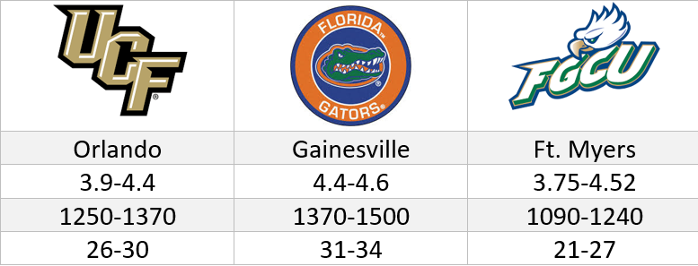
Example of State University System Freshman Profiles

Slide 8
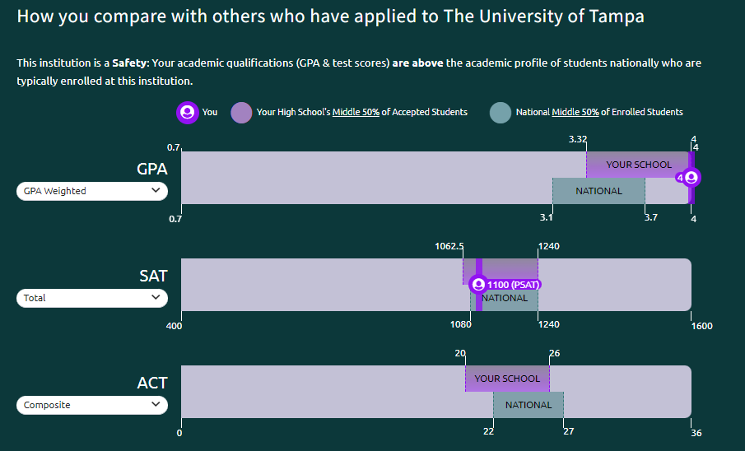
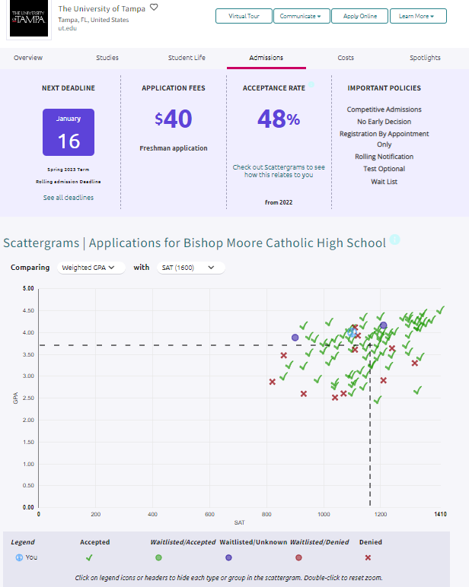
Naviance Information Available

Slide 9
Summer Before Senior Year Checklist
Continue to refine college list
Begin writing college essay (Common App prompts)
Continue to take ACT or SAT tests, if necessary
Schedule meaningful summer experiences
Update resume
Start working on college applications
August 1 (or before)

Slide 10
Fall of Senior Year
Meet with College & Career Counselor
Participate in CAP (College Application Planning) Day
Finalize college essay (assistance in English class)
Ask recommenders to write letter of recommendation in person and provide resume
Submit college applications

Slide 11
College Application Basics
Aim to apply to 4-8 colleges
May add more if applying to extremely selective colleges (35% acceptance rate or less)
Expect to pay between $30-100 each application
Institutional vs. Common Application
Early Action, Early Decision (binding), Rolling, Regular Decision
Test optional policies
Stay organized (login, requirements)
Watch for deadlines- apply early!

Slide 12
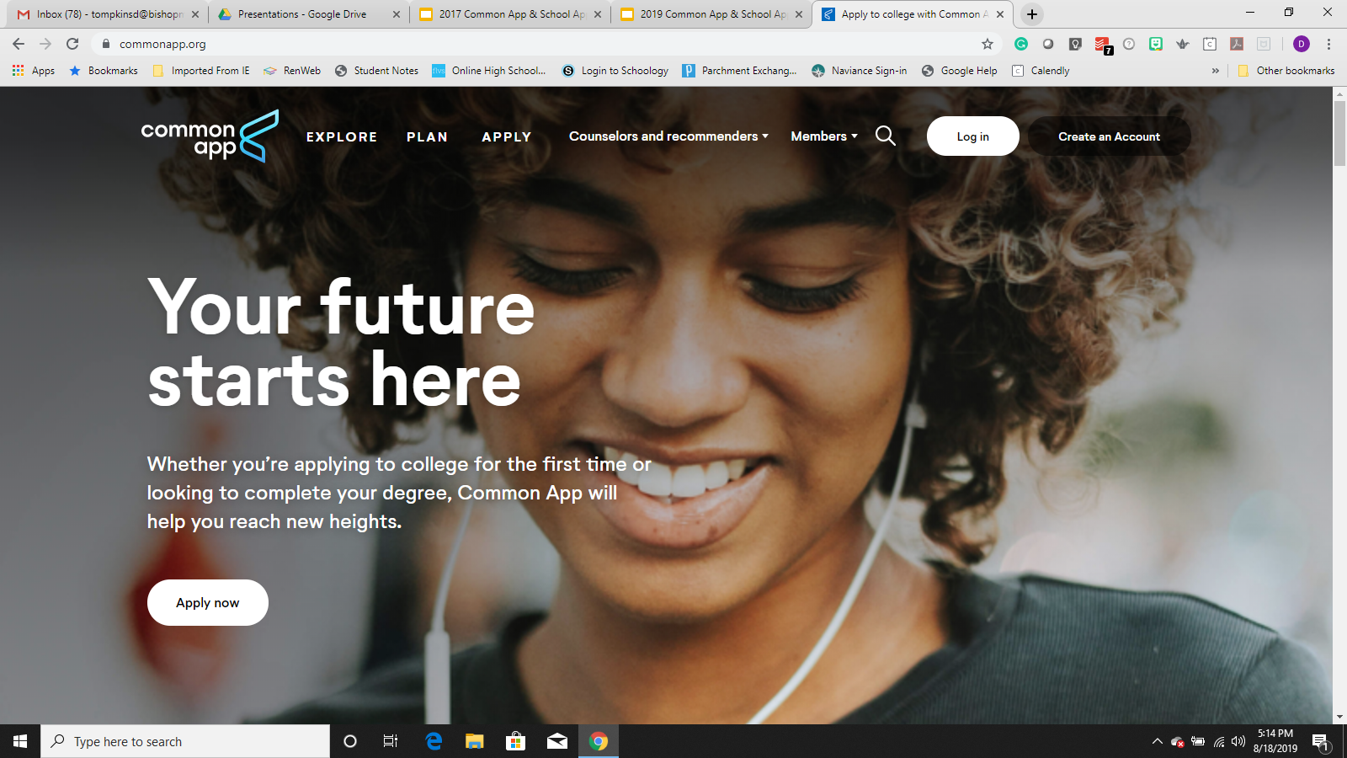
Common Application Overview

Slide 13
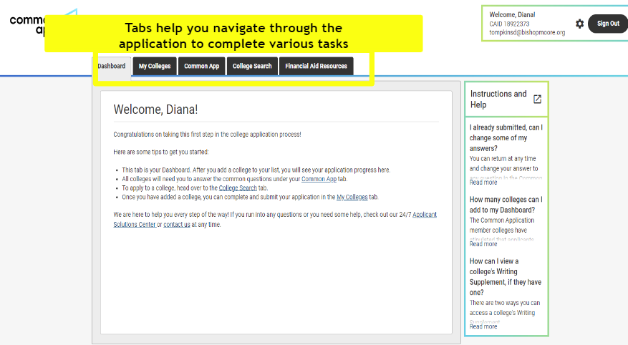
Common Application Overview

Slide 14
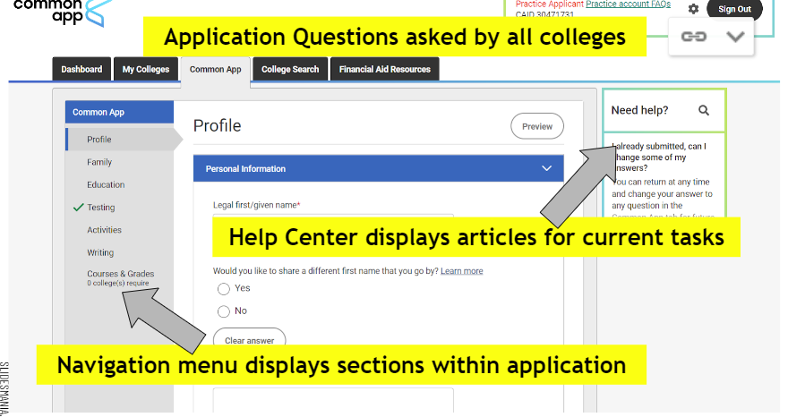
Common Application Overview

Slide 15
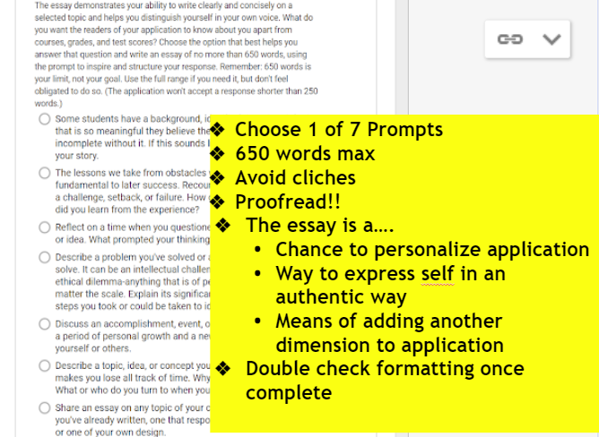
Common Application Overview

Slide 16
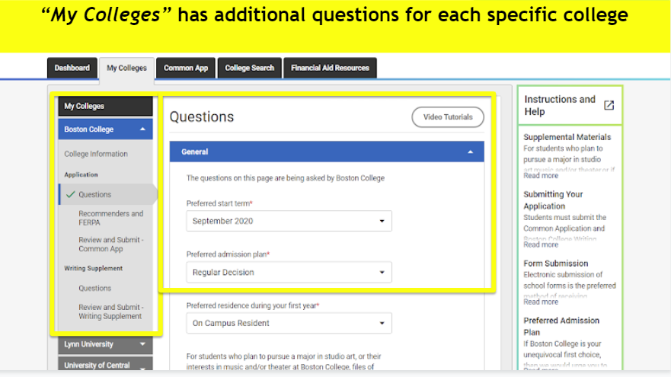
Common Application Overview

Slide 17
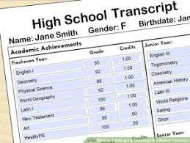
After Submitting Your Application
Each college needs high school transcript in some form
Official transcript from Parchment
SSAR (self-reported transcripts)
SPARK (UCF specific form)
Courses and Grades on Common App

Slide 18
After Submitting Your Application
Test Scores
Student submits official test scores through College Board (SAT) or ACT. Allow 2 weeks to process.
Limited number of schools may allow to self-report on portal. Will follow-up with official scores if attending college.
If applying test optional- do not send test scores

Slide 19
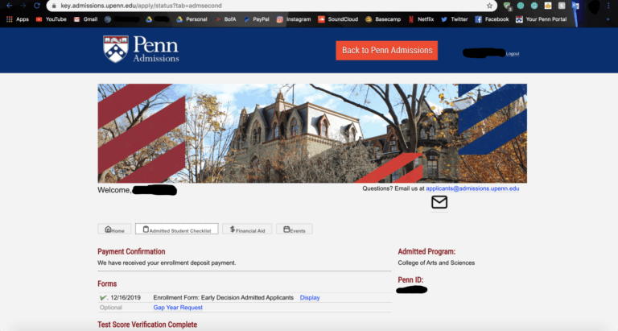
Create and Check Applicant Portals
Each college will email directions on setting up applicant portal account
Keep login information
Will show if anything is missing
Link SSAR/ self-report test scores for some colleges
Parent residency information
Check frequently
Admission decisions posted

Slide 20
Questions?

