Slide 1
College Admissions: Truths & Trends
Presented by Jennifer Etscorn & Gracie Mazanec
Bishop Moore Catholic College & Career Team

Slide 2
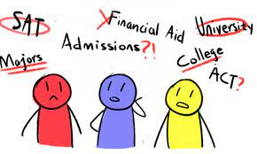
KNOWLEDGE IS POWER

Slide 3
A Look At College Admissions Trends
Increase In Number Of Applications- Including ED & EA
Test Optional Admissions: Understanding What That Means
More Students Deferred & Put On Waitlists
Changing Admissions Rate- Do your Research!

Slide 4
A Look At Present Day College Admissions
What Is “Yield”?
Some strategies that colleges have implemented to help predict yield as application numbers rise:
* The addition of Early Decision & Early Action deadlines
* The creation of alternate pathways (spring/summer starts,
semester abroad, alternate campuses, direct connect)
* Switching from holistic approach to quantitative

Slide 5
What Test Optional Really Means
Submit test scores if they positively reflect capabilities. (Scores should fall in or above the 50th percentile of the prior year’s accepted students’ scores.)
In true test optional admissions, colleges consider other aspects if there are no test scores (transcript, class rigor, extracurriculars, recommendations & supplemental essays-)

Slide 6
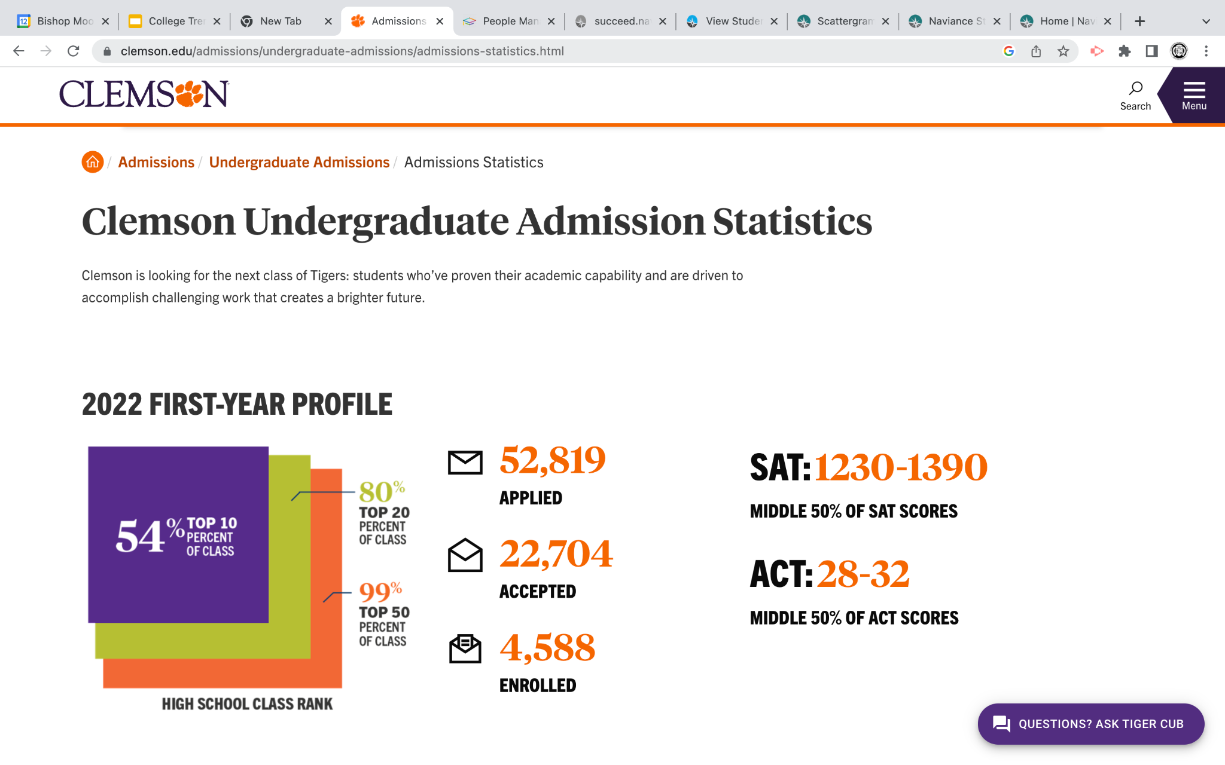

Slide 7
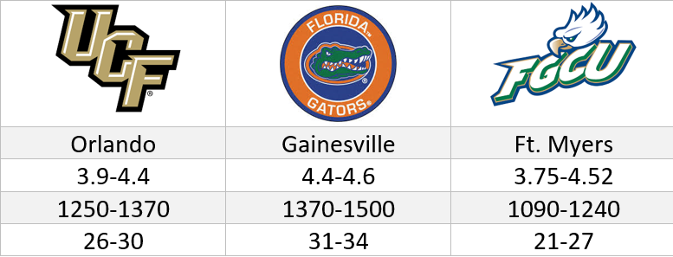
Examples of Freshman Class Profiles

Slide 8
What Test Optional Really Means
“Test blind” colleges will not consider test scores in admissions.
Strong test scores carry weight- especially at more selective colleges!

Slide 9
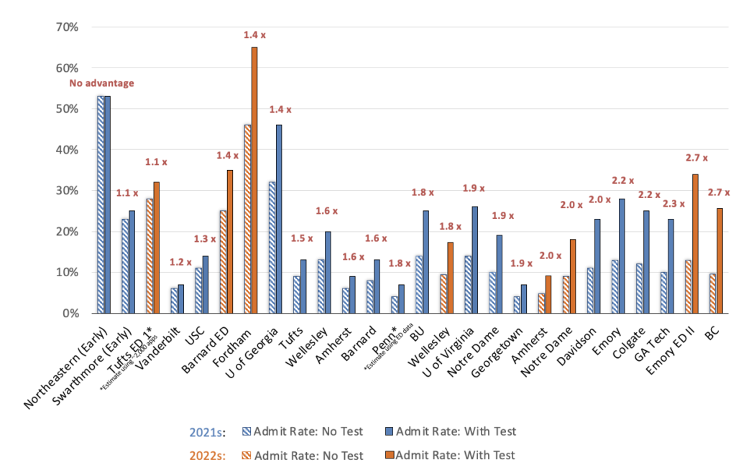
Advantages of Test Scores At Highly Selective Schools

Slide 10
Deferrals & Wait Lists
Early admissions outcomes: admitted, denied, or deferred to Regular Admission
Students not admitted or denied under Regular Action may be offered a spot on the wait list. (The Common Data Set provides information about how schools utilize their wait lists.)
If applying Early Decision or Early Decision 2, be strategic!

Slide 11
The Change In Admissions Rates
Times have changed- so have admissions statistics!
Do your research to uncover what schools
prioritize in an applicant.
Use current information (provided in a college’s
“Freshman Profile” or in Naviance) to
access information on prior years’ admissions.

Slide 12
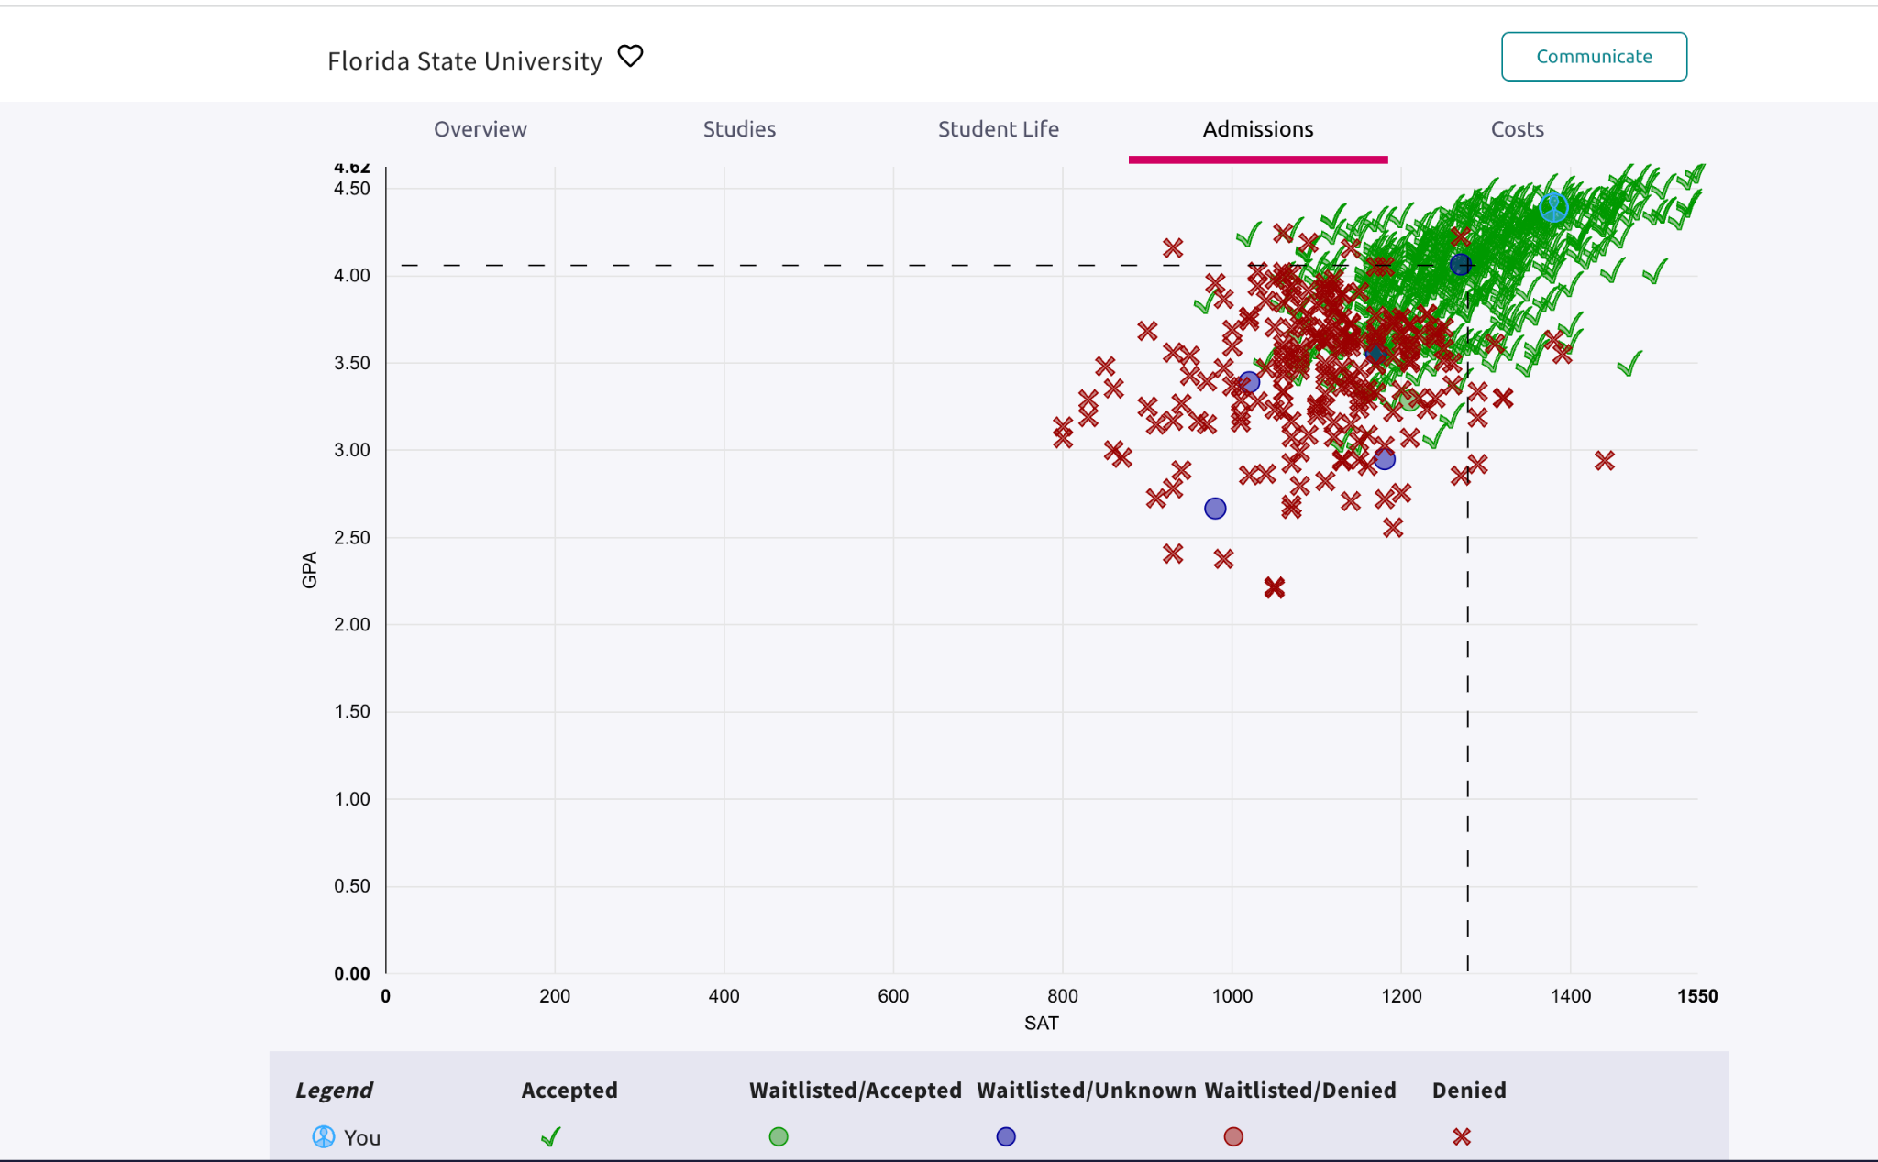

Slide 13
Advice for Underclassmen
Keep grades strong
Choose meaningful commitments
3. Show dedicated participation & continuity in activities
4. Make a testing plan
5. Celebrate differences

Slide 14
Tips for Successful Admissions Outcomes
Build a BALANCED list.
2. Keep an open mind and consider “fit” over rankings or reputations.
Seek out a few schools with higher admit rates that have special
programs in your student’s area of interest.
3. Quality applications and strong essays take time!
4. Research. Check out college websites. Attend a College Fair. Visit
college campuses to get a true sense of a school and to demonstrate
interest.

Slide 15
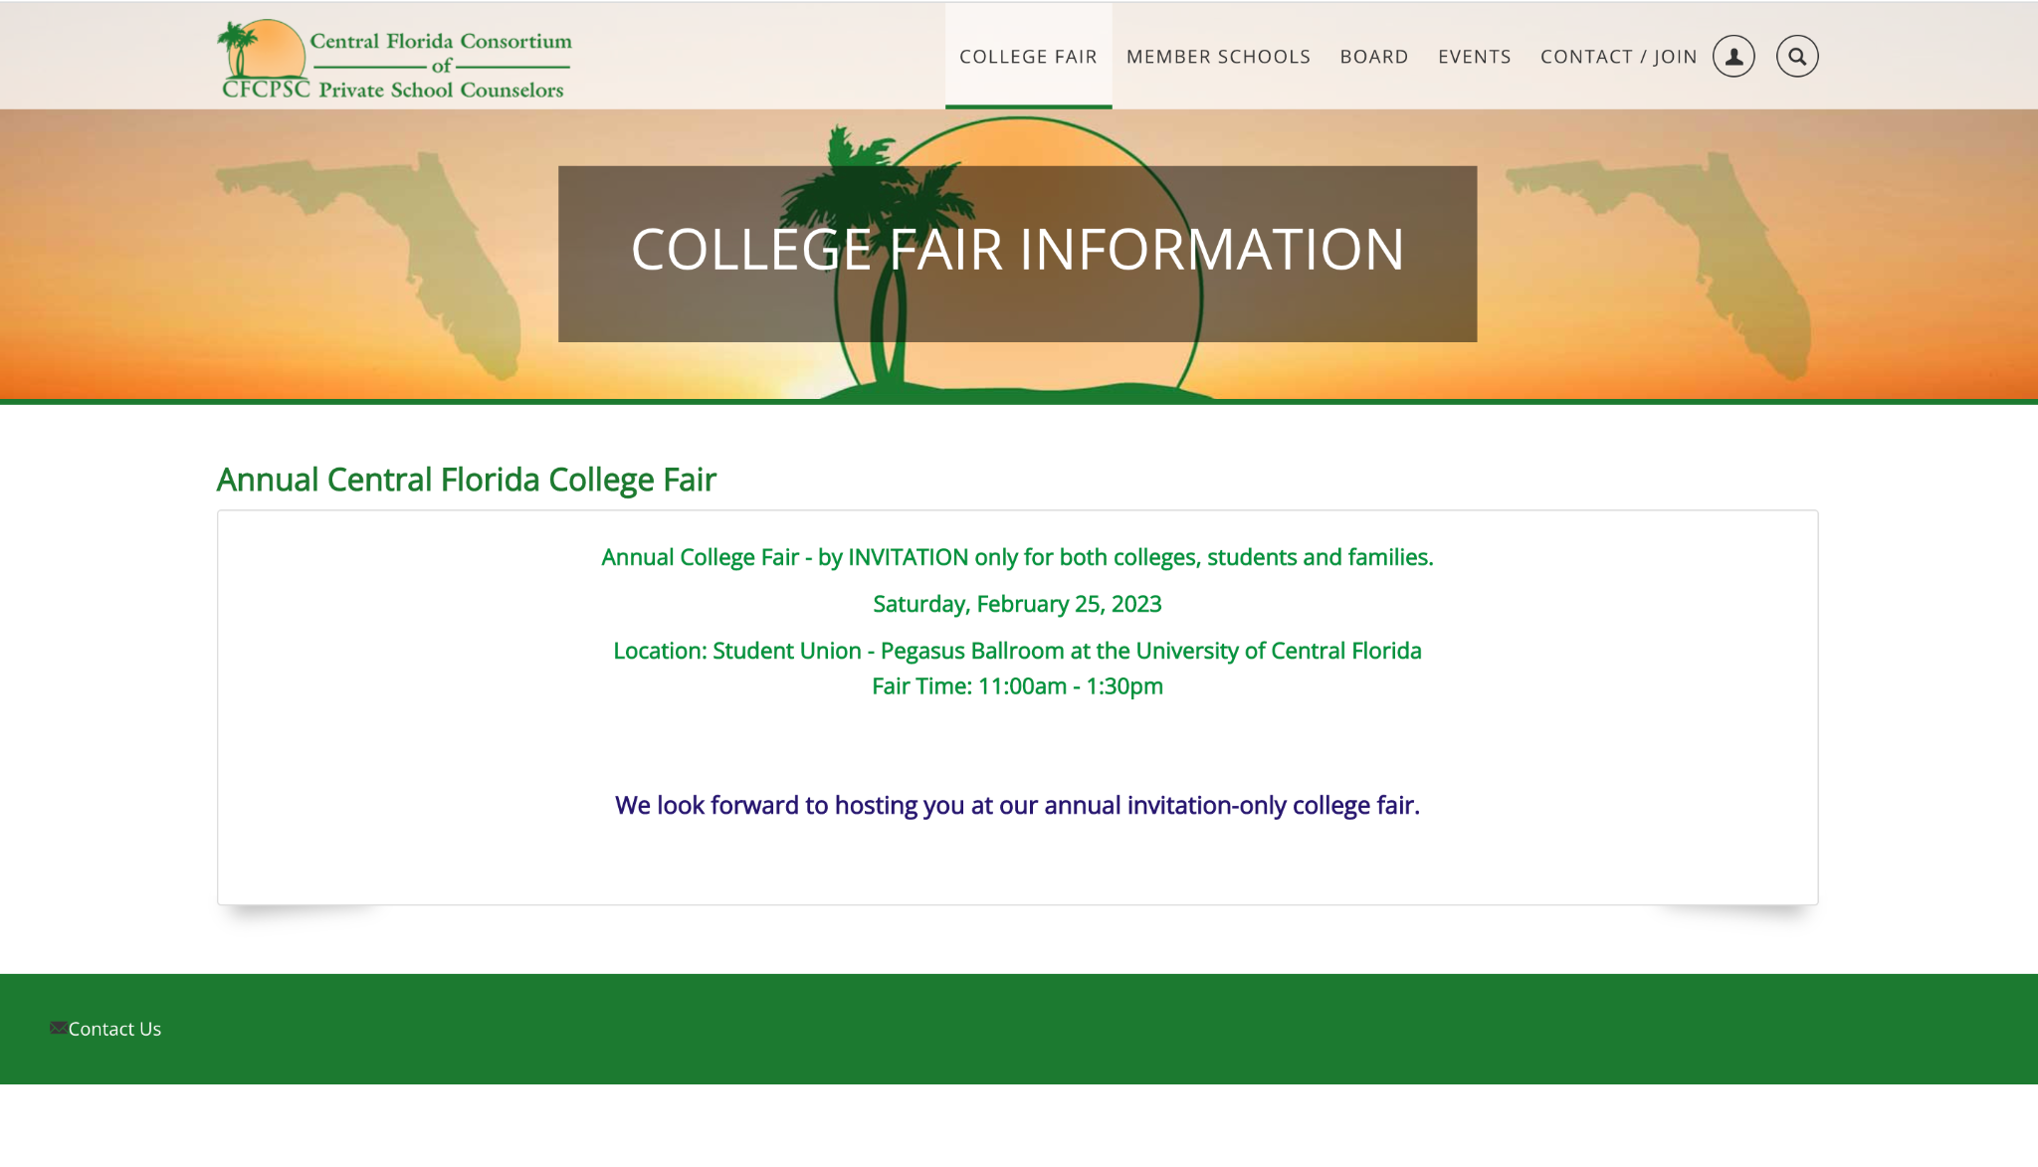
Central Florida College Fair

Slide 16
QUESTIONS?

