Slide 1
How to Complete your
STARS Form
September 30, 2025
College & Career

Slide 2
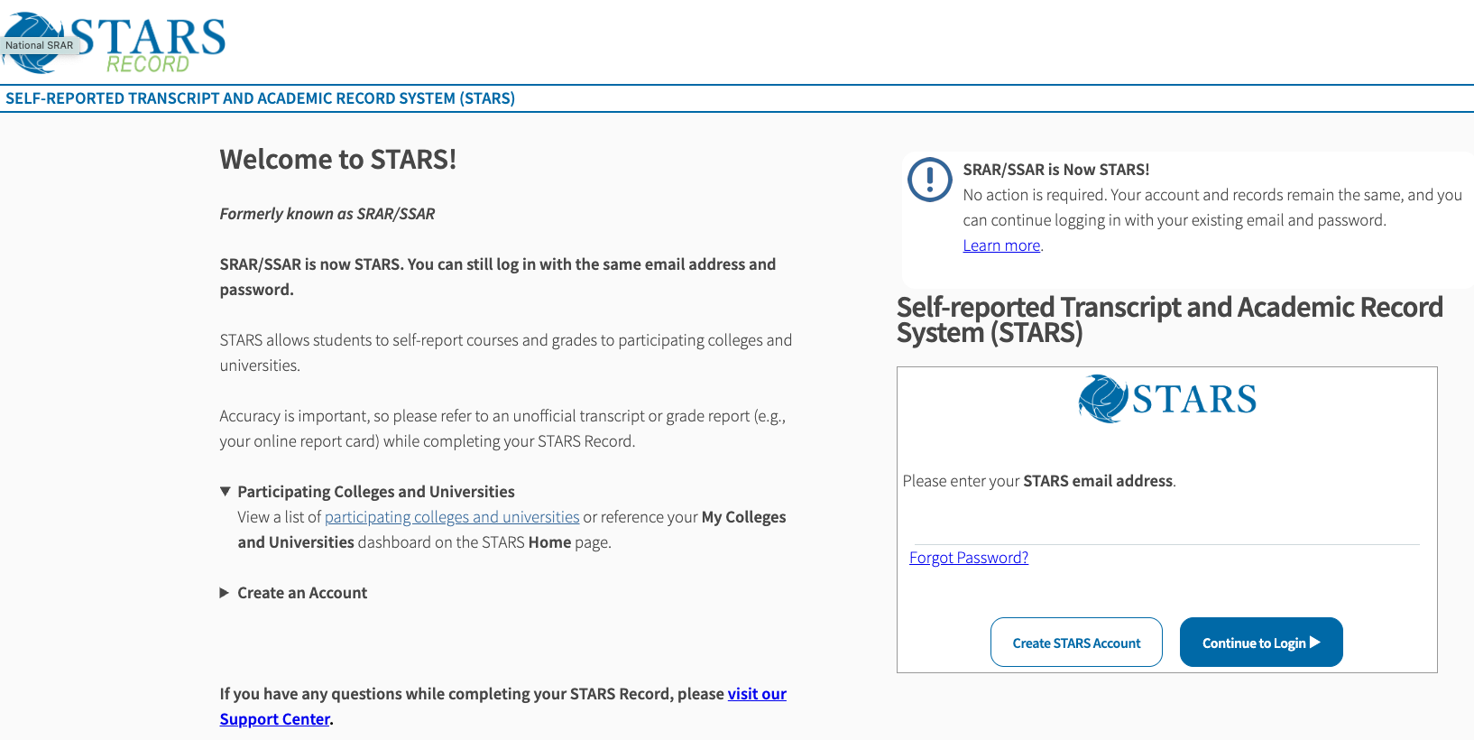
Welcome Page

Slide 3
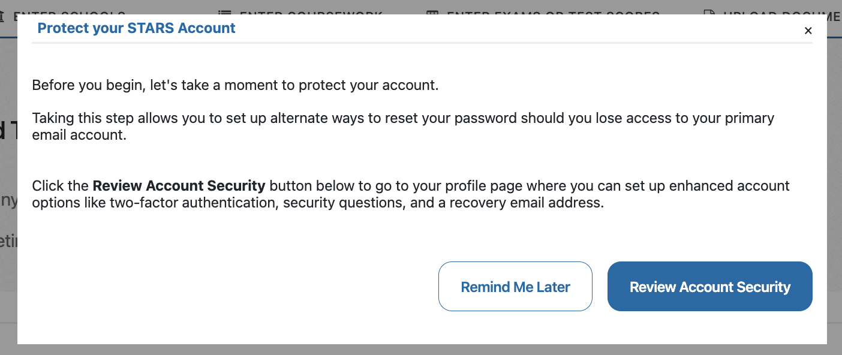
Home Dashboard
It’s your choice to enhance account security now, later, or not at all.

Slide 4
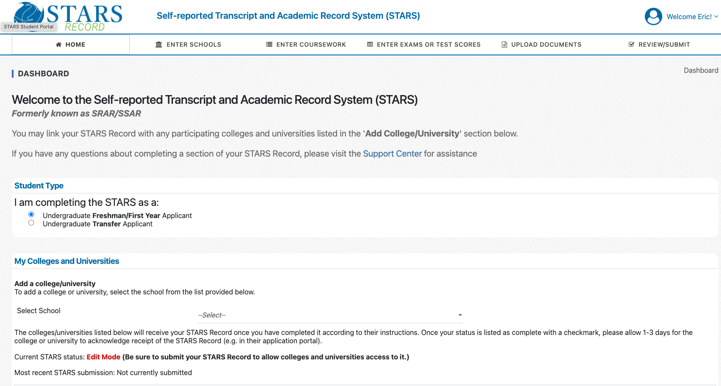
Home Dashboard

Slide 5
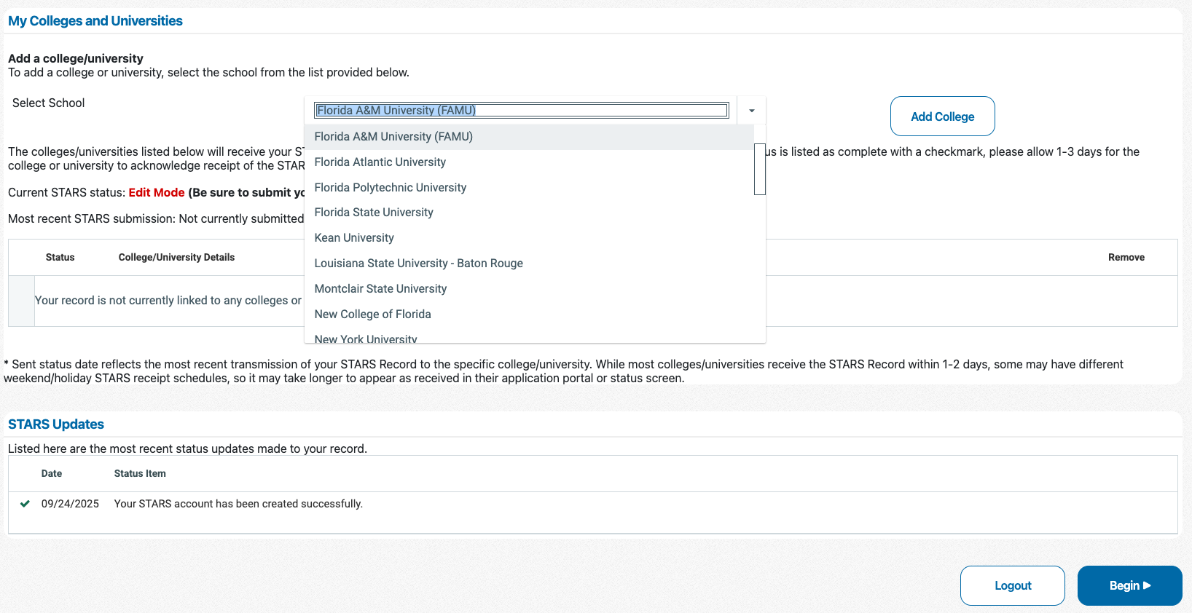
Home Dashboard

Slide 6
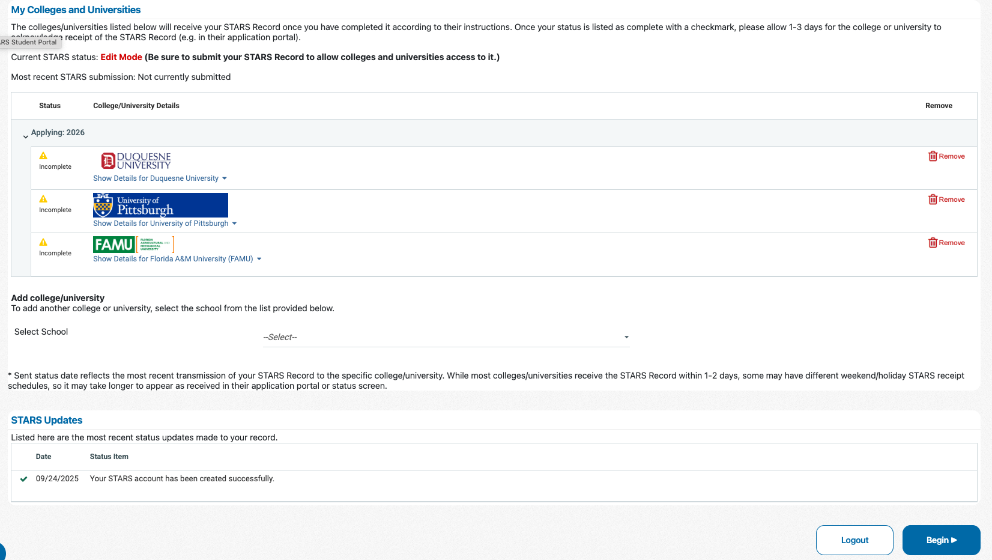
Home Dashboard

Slide 7
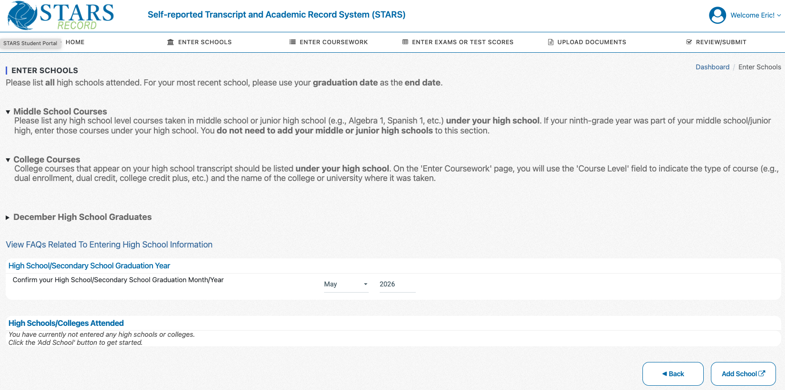
Enter School(s)
READ CAREFULLY!!!
“Middle School”
XXXXXXX
XXXXXX
= May 2026

Slide 8
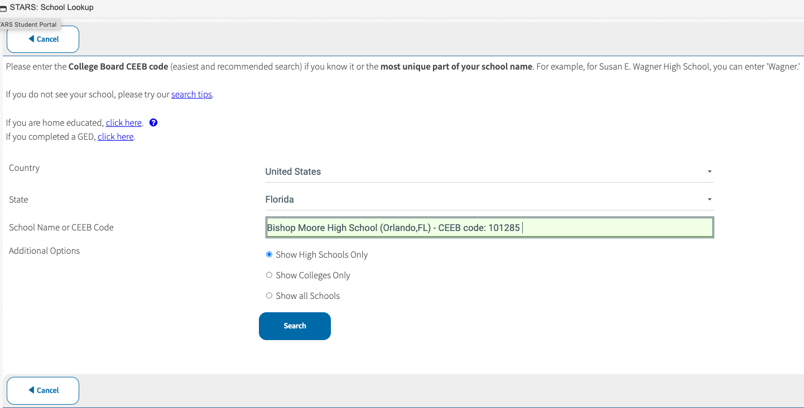
Pop-up: Enter BMC

Slide 9
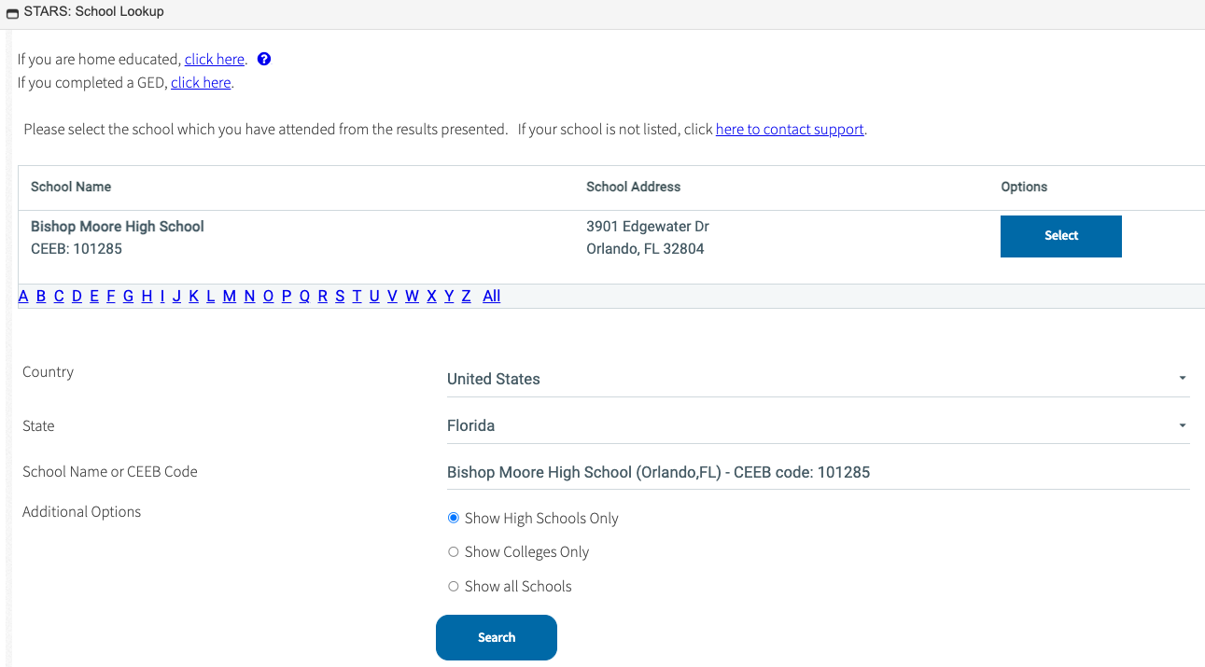
Pop-up: Select BMC

Slide 10
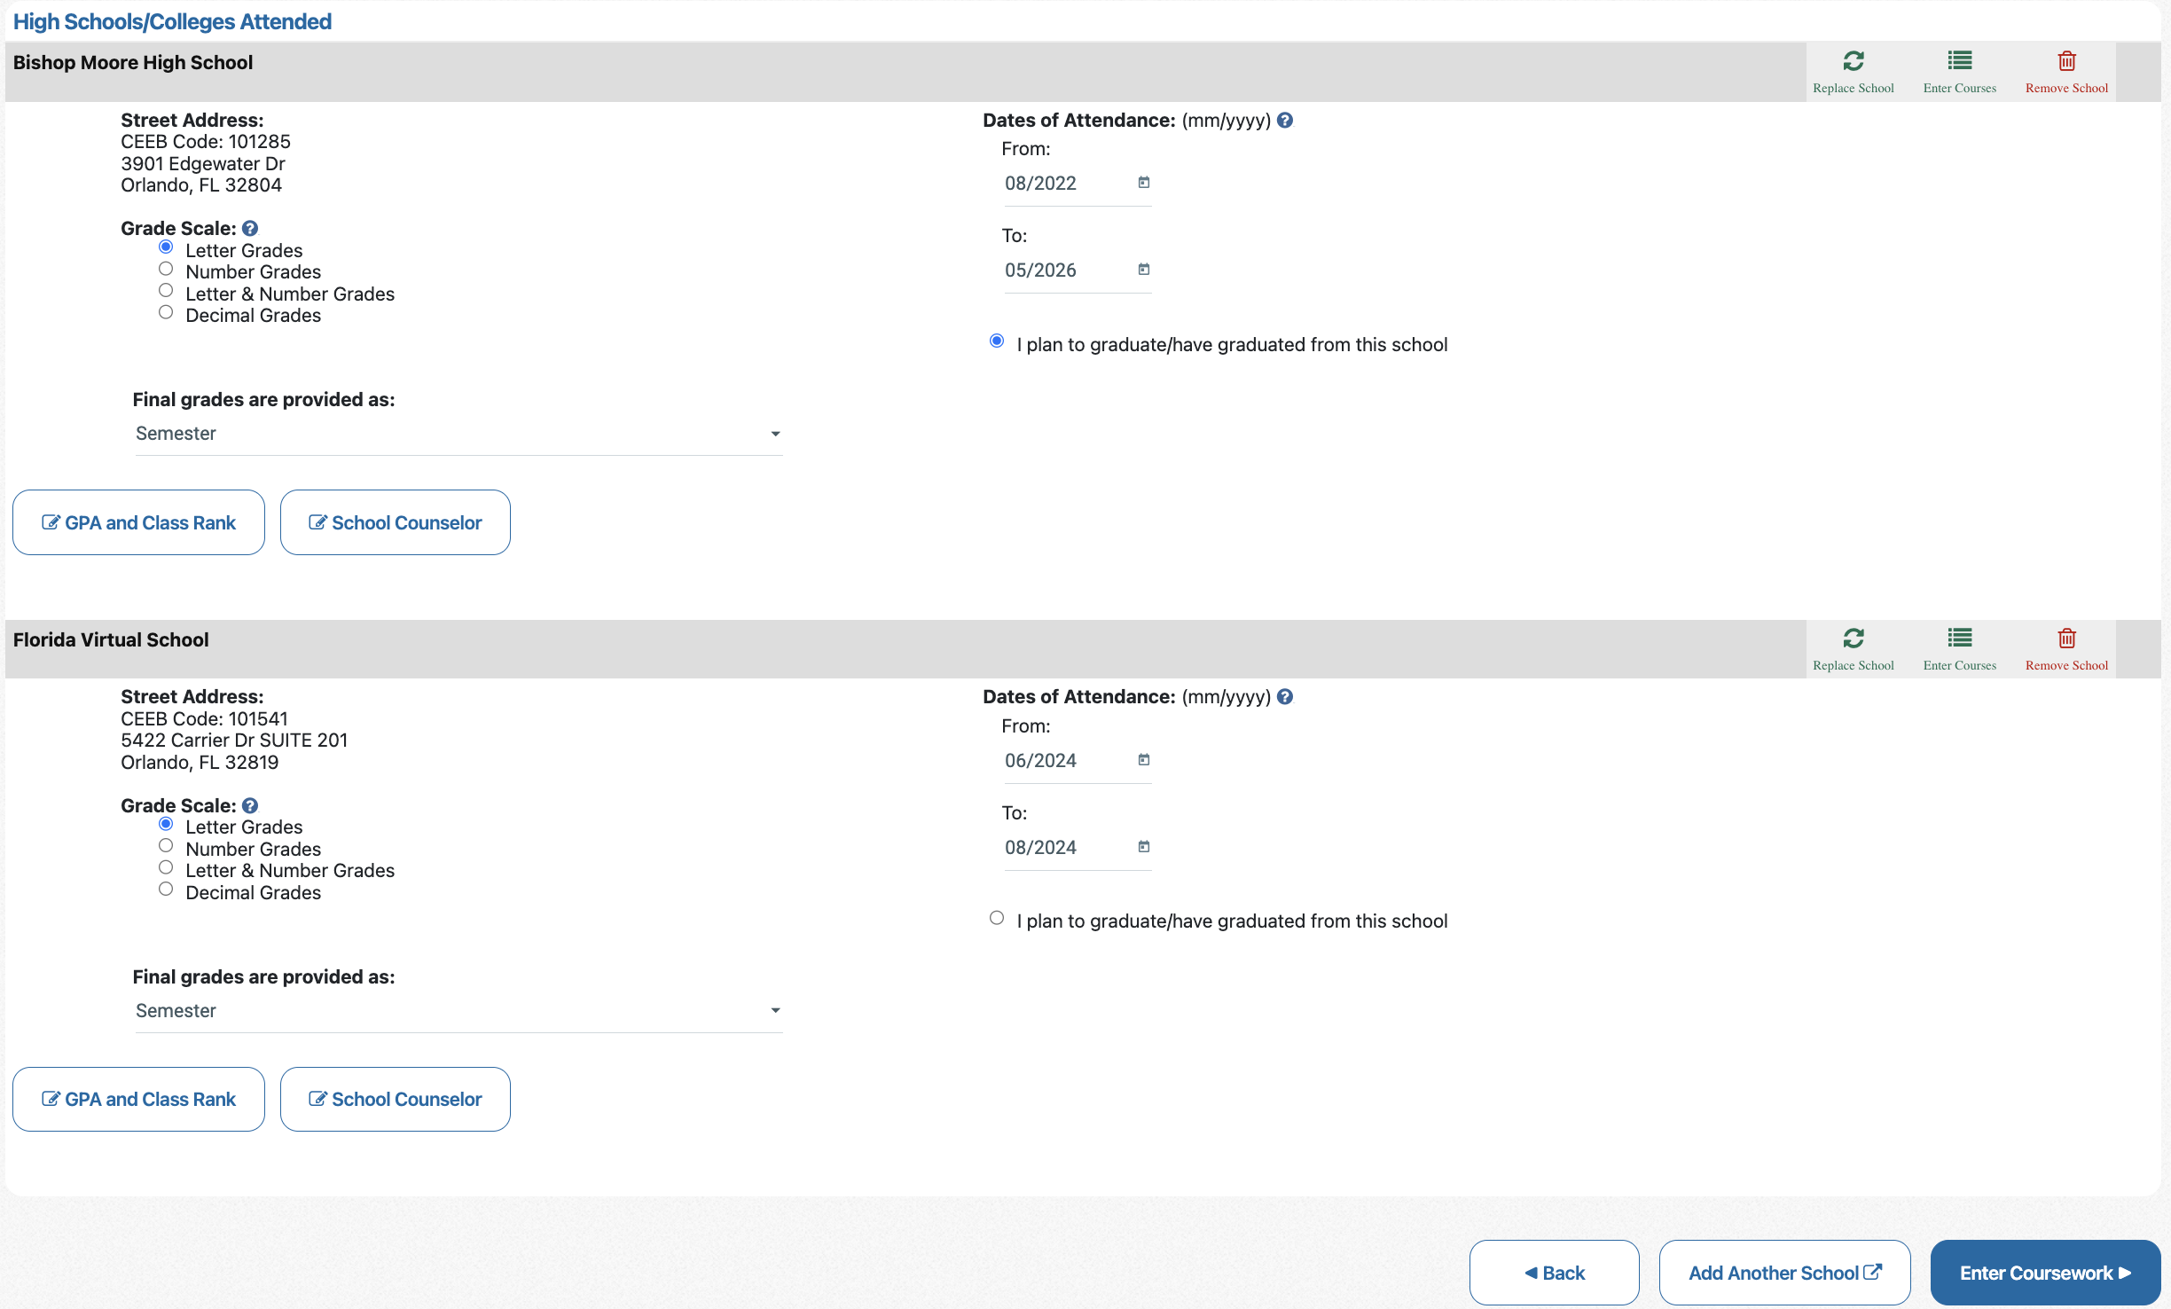
Enter School(s)
“Add Another School” at the bottom of
this screen for transfer students or for FLVS coursework.

Slide 11
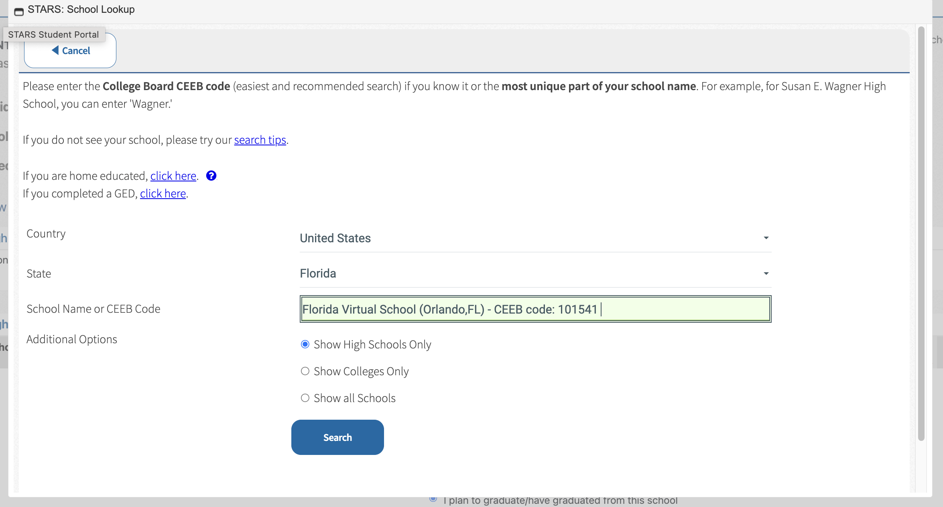
Pop-up: Enter FLVS

Slide 12
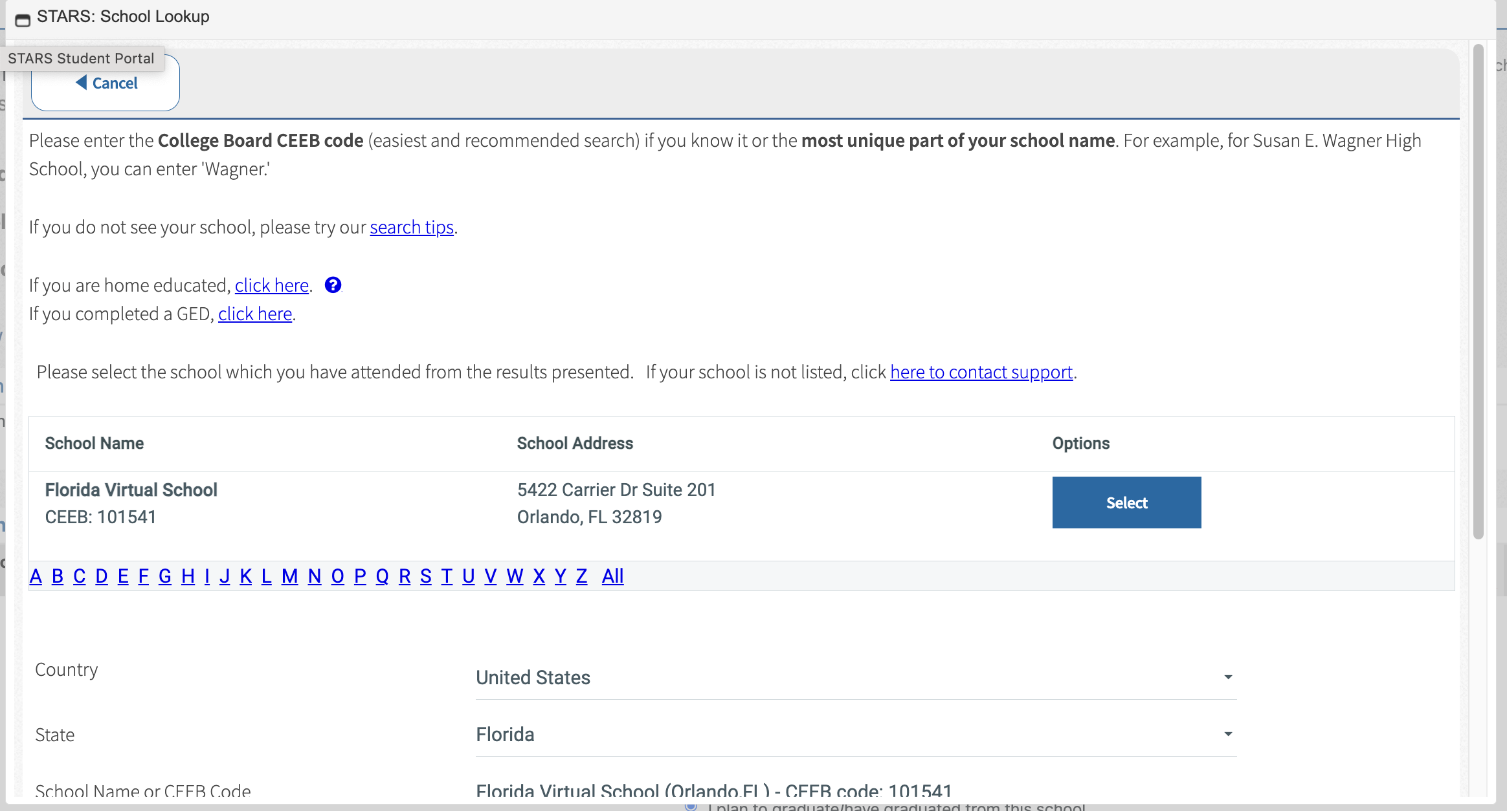
Pop-up: Select FLVS

Slide 13
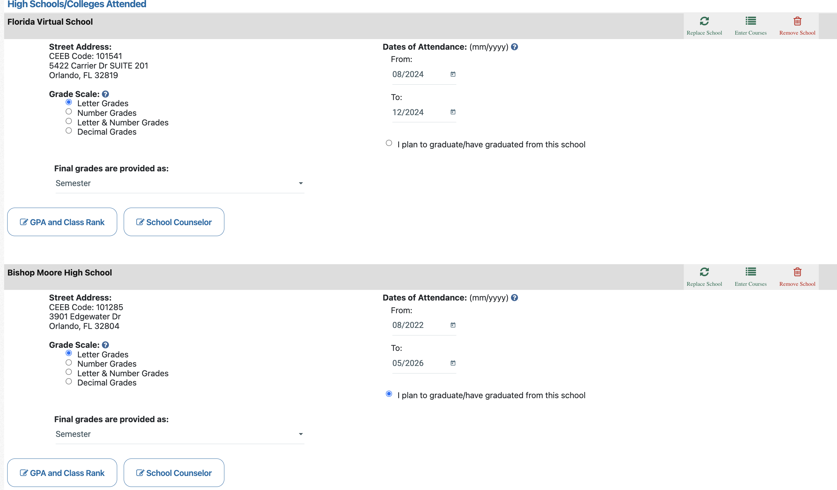
Enter School(s)
FLVS
= When you did FLVS
= Letter
= Semester
BMC
= When you started BMC
(06 for summer / 08 for fall
Alma Mater = BMC

Slide 14
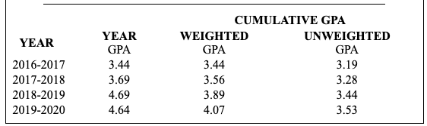
Before Adding GPAs…
Have your unofficial transcript readily available.
Know how to distinguish your GPAs from each other.
There is no 12th grade GPA available until January.

Slide 15
Before Adding GPAs…
Your YEAR GPAs are entered on your 9th/10th/11th coursework screens.
Your current cumulative, weighted GPA is the bottom number.
Your current cumulative, UNweighted GPA is also the bottom number.
Your YEAR GPA is what you earned ONLY during that school year.

Slide 16
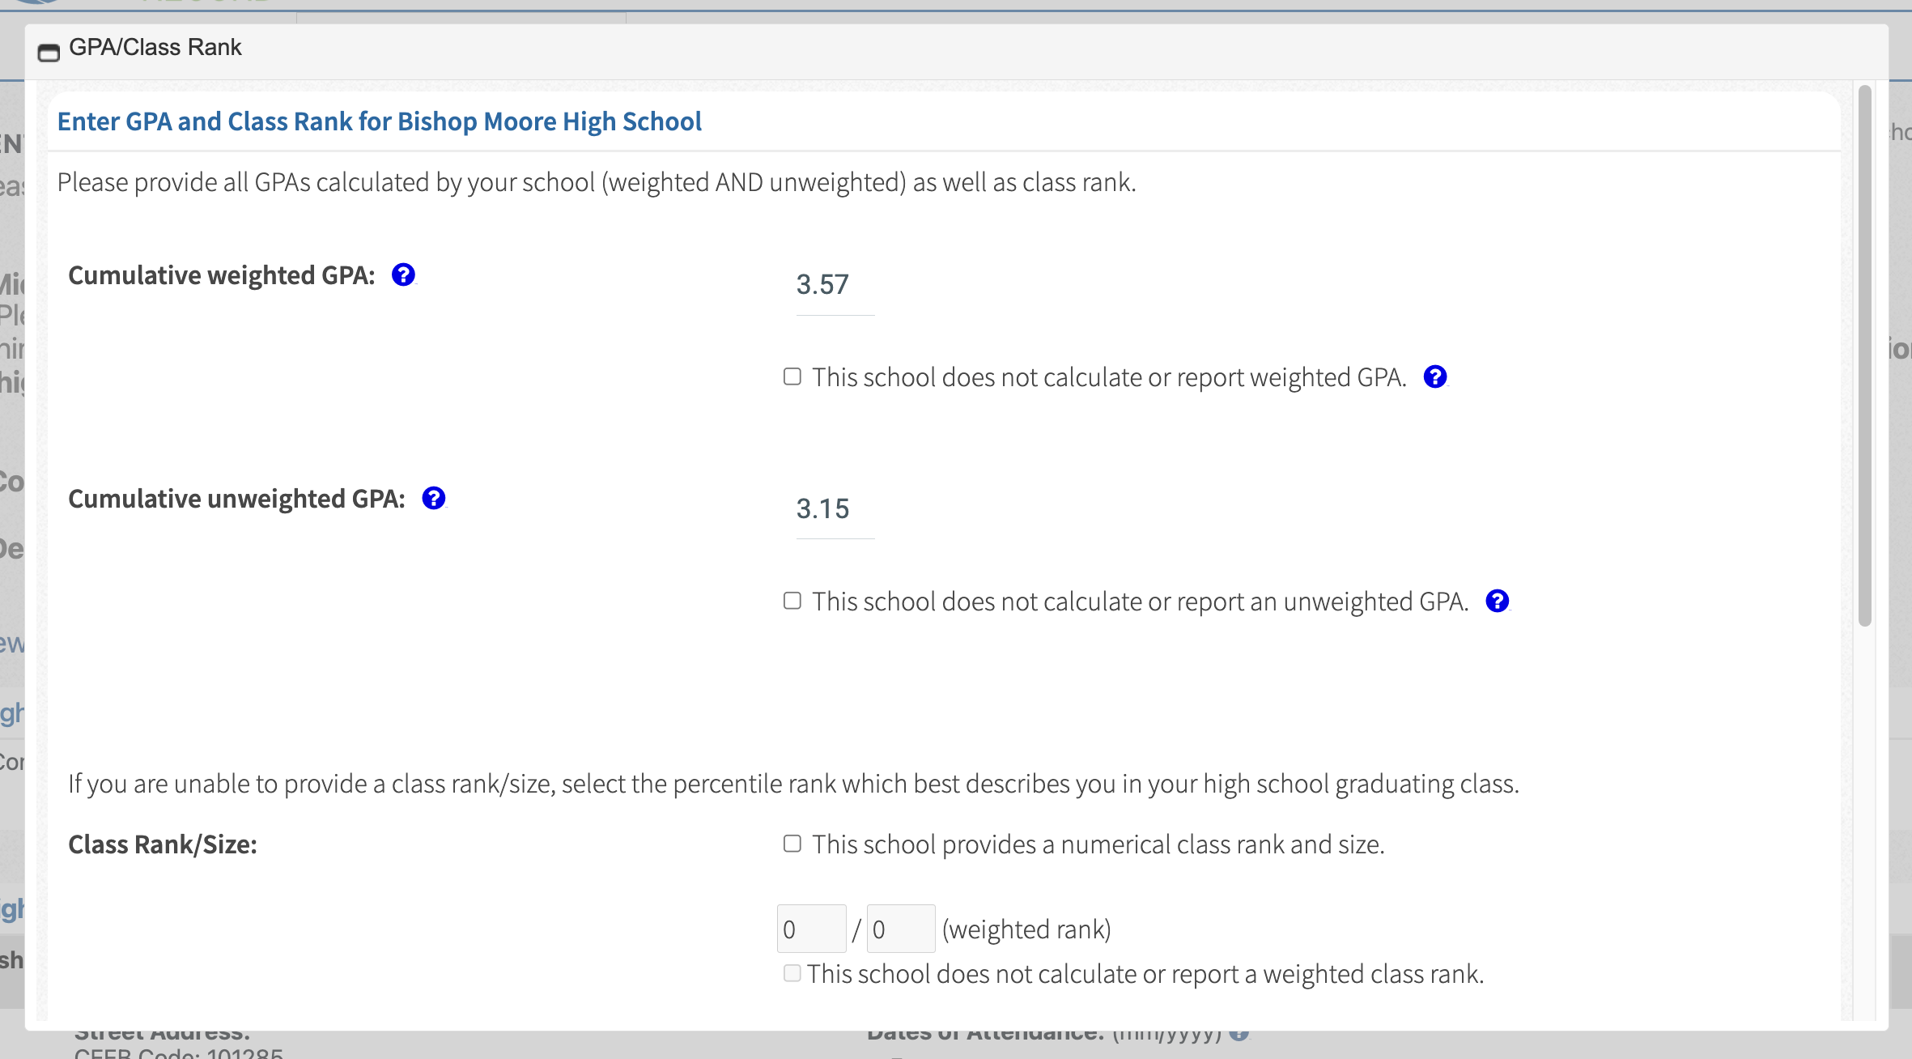
Pop-up: GPA & Class Rank
Select:
“This school does not provide rank…”

Slide 17
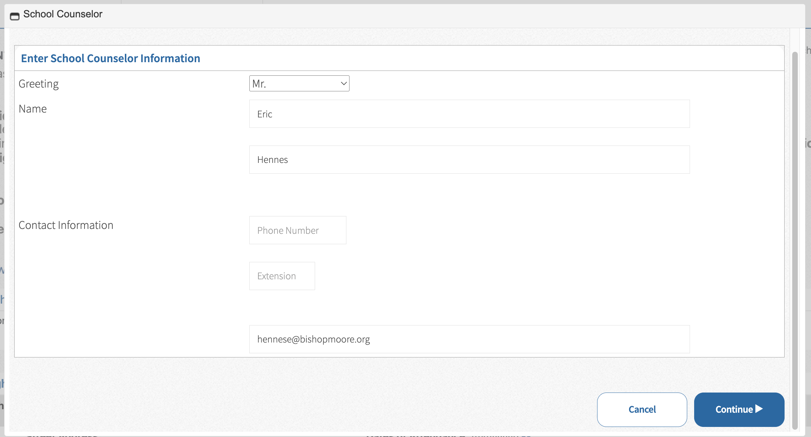
Pop-up: Counselor Info
NO!!! Add College & Career Counselor
= Cherry, Croom, Hennes, McLeod, or Mulford
Counselor email

Slide 18
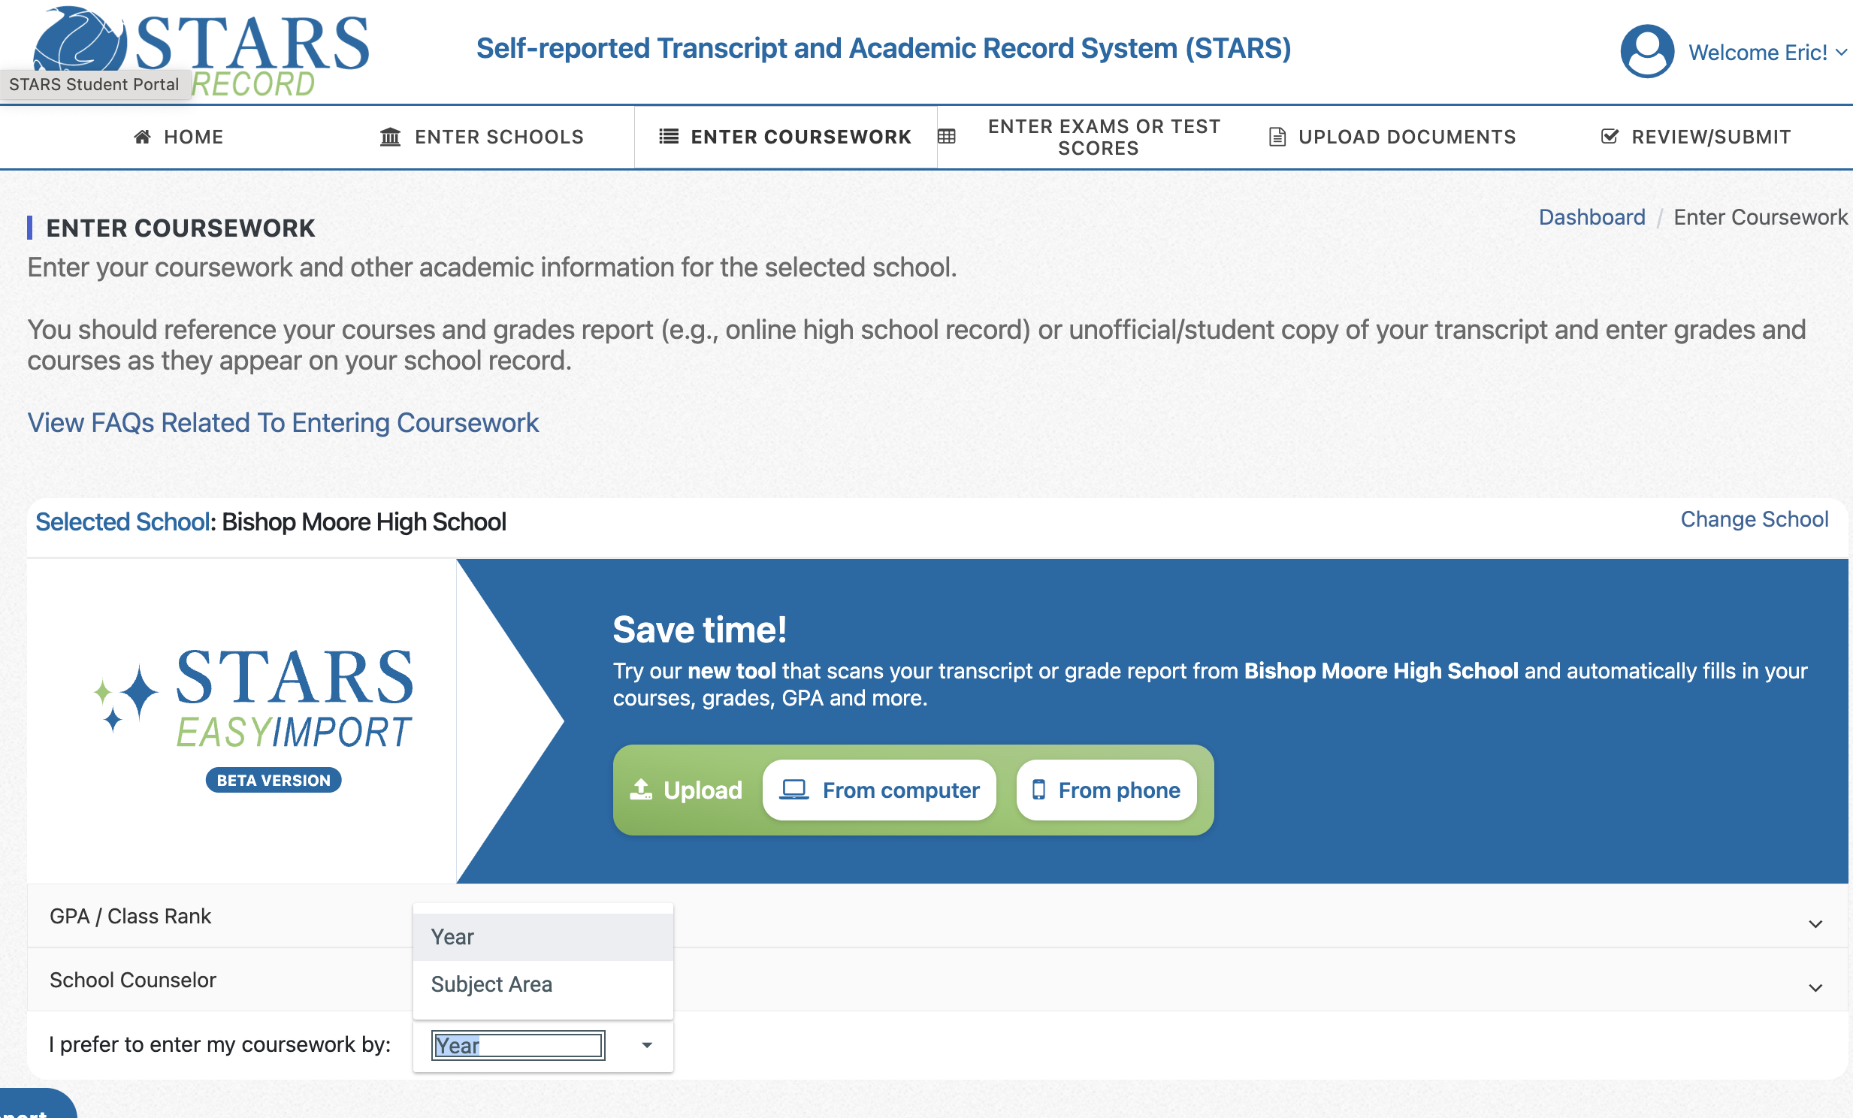
Enter Coursework
By year is better than subject; less chance for error.

Slide 19
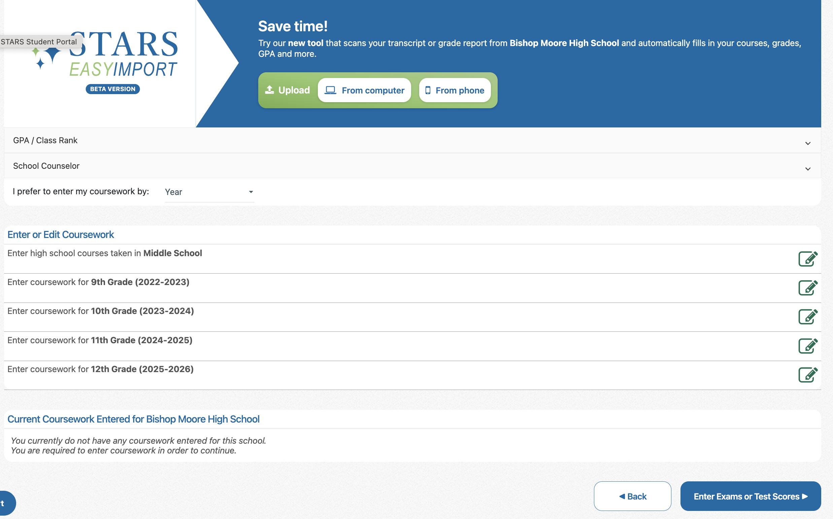
Enter Coursework
Enter courses year by year under correct school.
Click on each grade to enter courses.
Must match transcript!!!
Screen navigation buttons are always at bottom of screen.

Slide 20
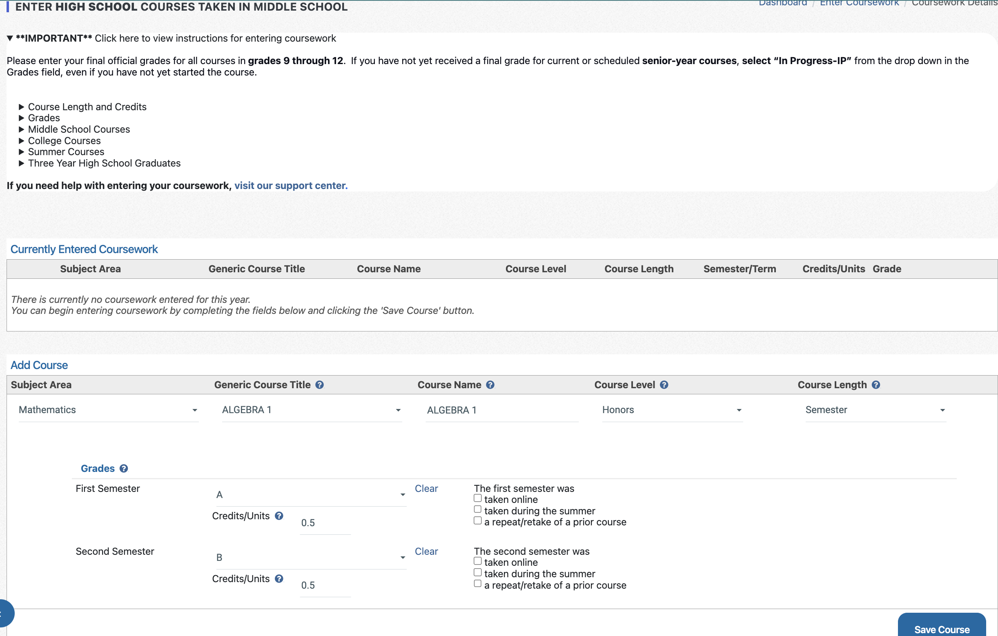
Enter Coursework
R-E-A-D BEFORE entering data!
ALWAYS semester
Grades/credits per semester
SAVE

Slide 21
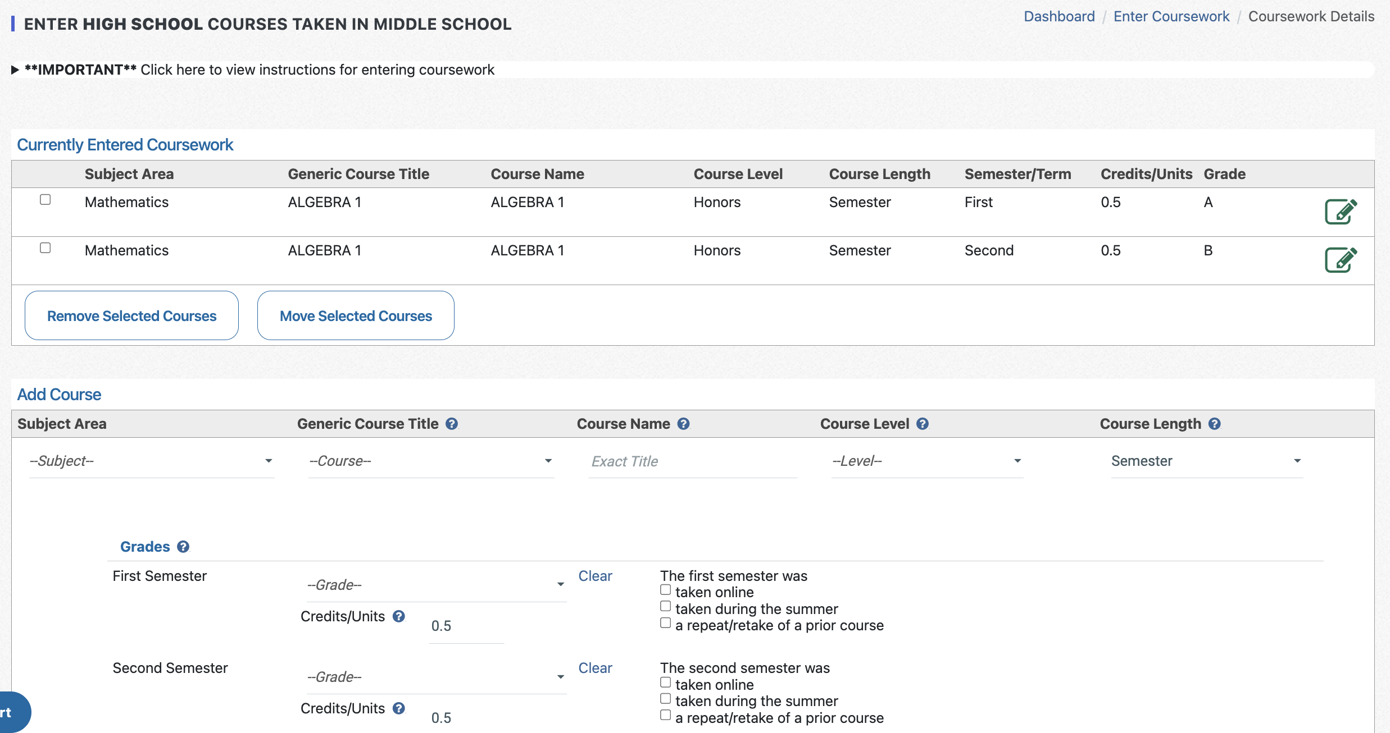
Enter Coursework
Ensure year is correct!!!
Check for accuracy

Slide 22
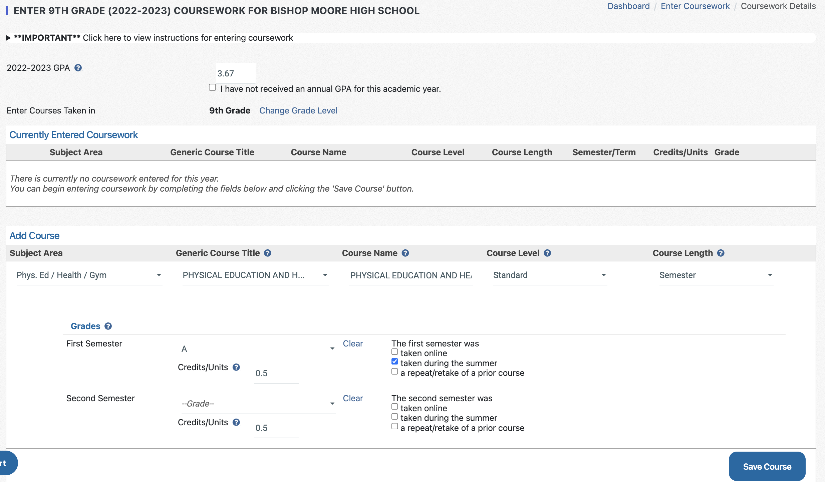
Enter Coursework
ALWAYS semester
Leave blank
SAVE

Slide 23
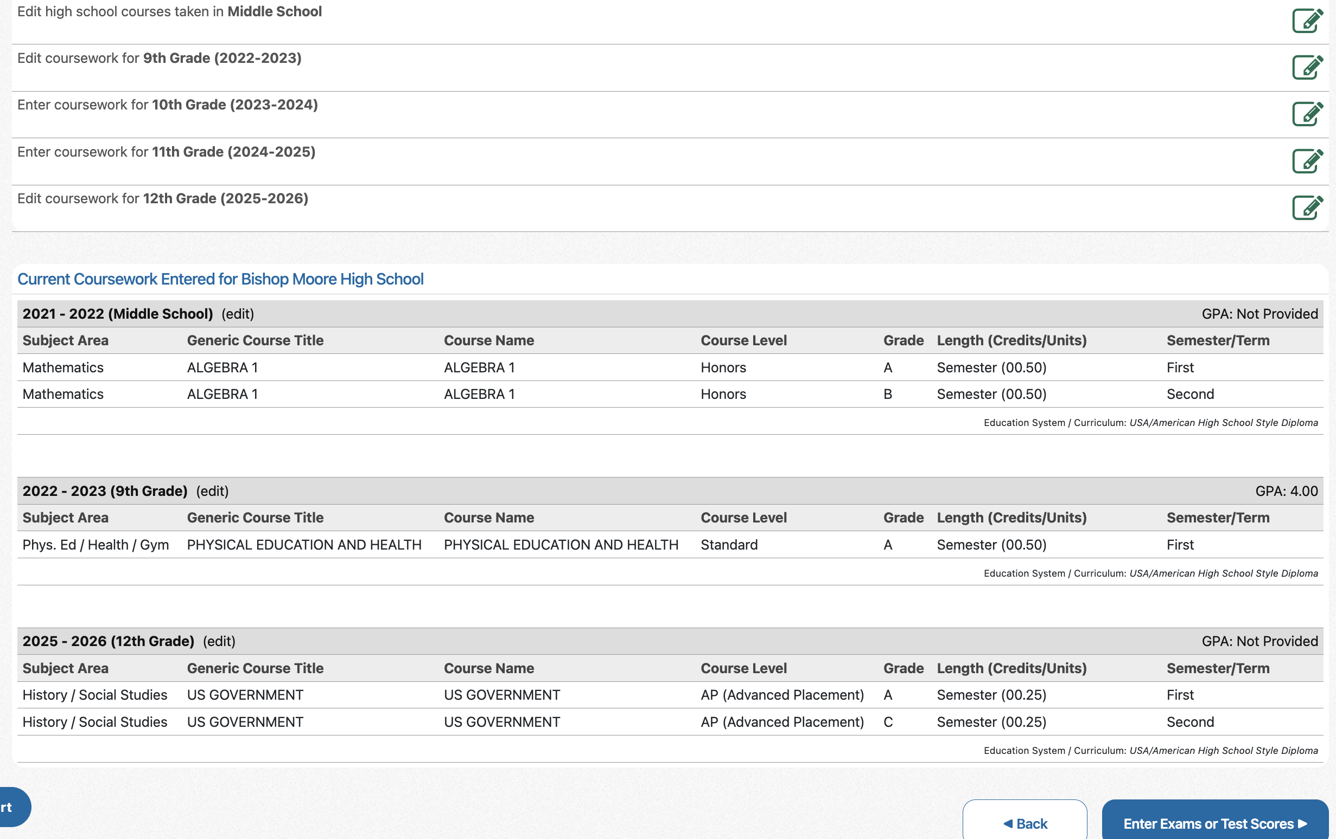
Enter Coursework
Edit data per year
Click to edit
Check
No 12th GPA yet
Notice AP
Next screen

Slide 24
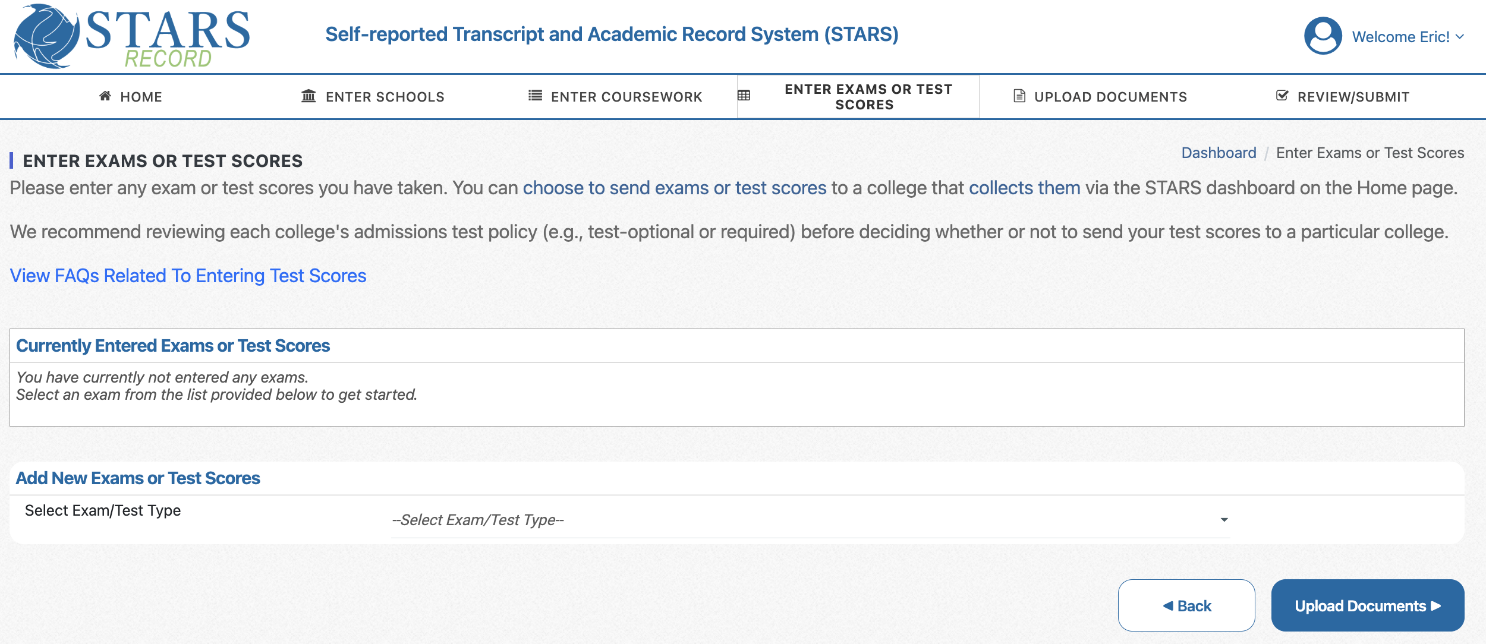
Enter Exams or Test Scores

Slide 25
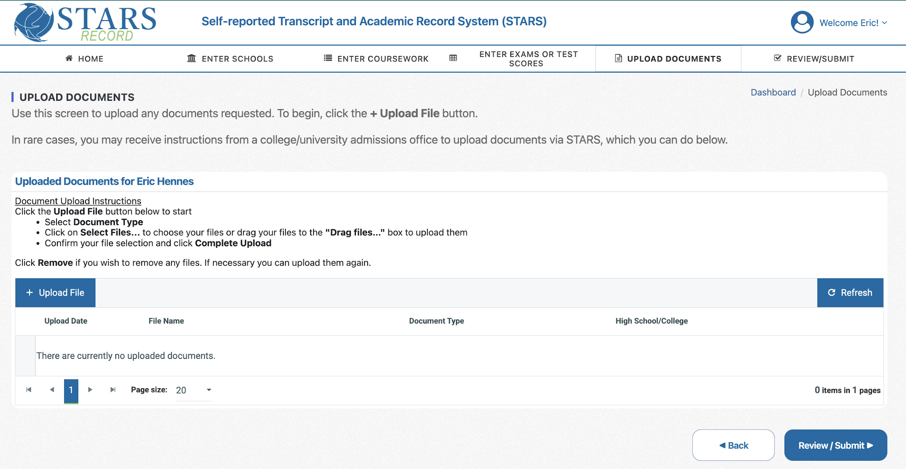
Upload Documents
Review / Submit

Slide 26
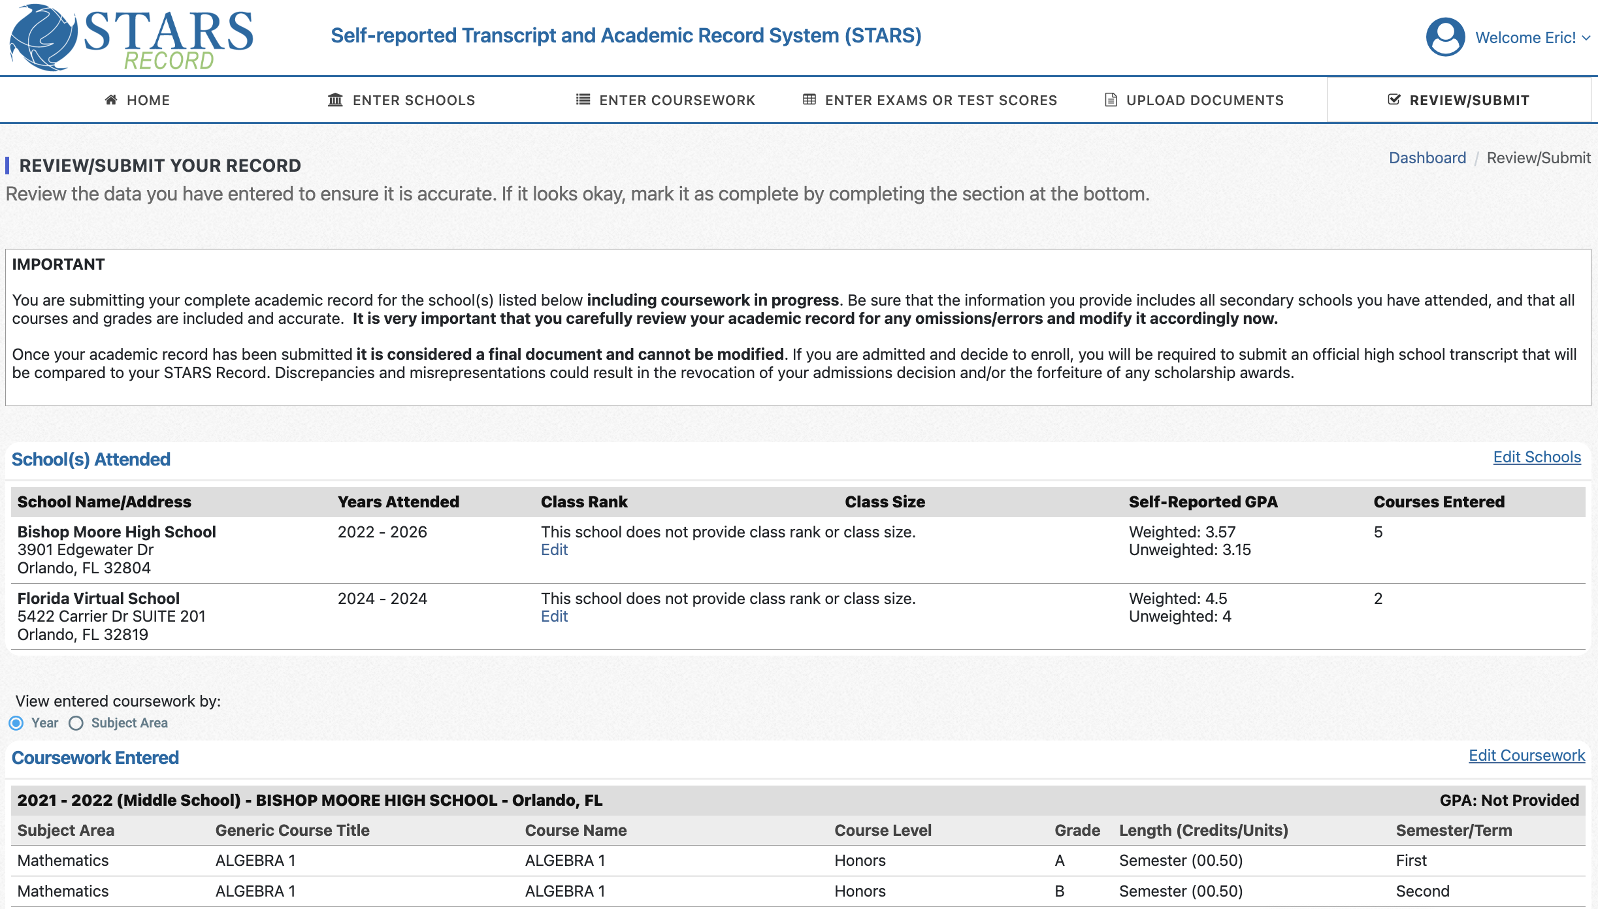
Review and Submit
R-E-A-D !
View by year to avoid errors

Slide 27
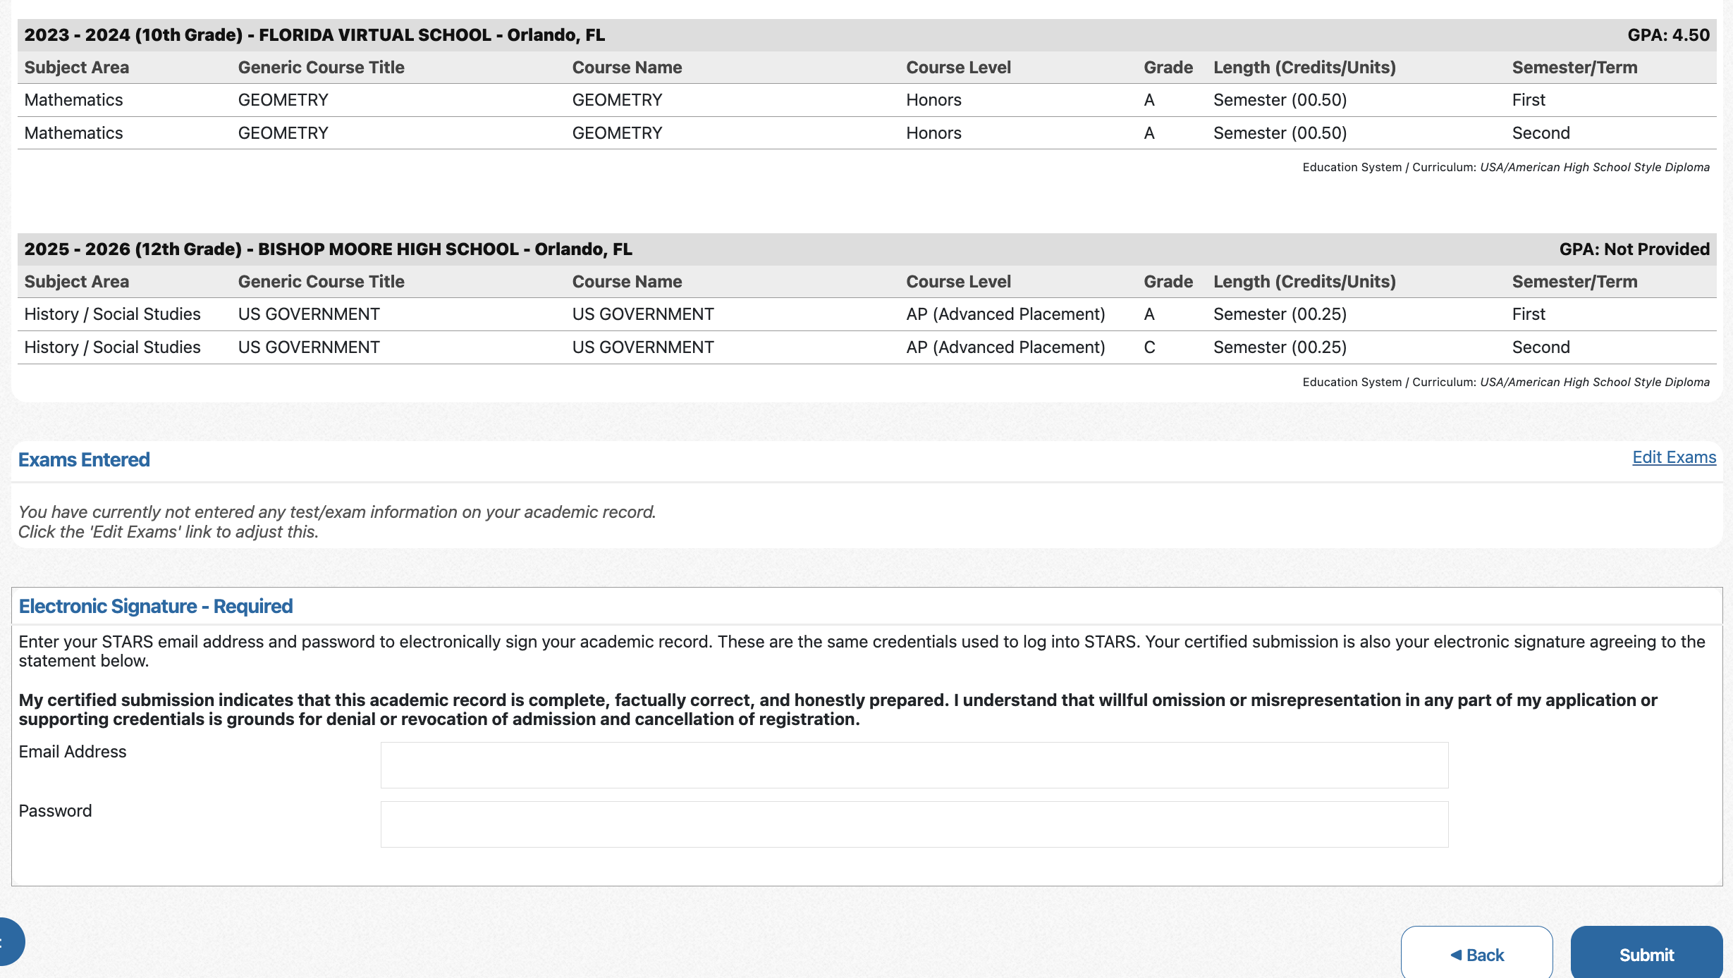
Review and Submit
Electronic signature = STARS username & password
SUBMIT !!!

Slide 28

Linking to College Applications
WE’RE NOT SURE HOW THIS WORKS.

Slide 29

Linking to College Applications

Slide 30
Linking to College Applications
1.) Your STARS record must be submitted first and then linked to your selected institutions in order for your grades to be
received.
2.) Linking methods vary per college.
3.) Where to get linking details:
* your application status portal
* the college’s admissions website
* official communications (like email) from the college

Slide 31
Linking to College Applications
Most Common Methods
STARS homepage>My Colleges/Univ dashboard> select the
school> “Show Details for…” >Current Status
Button / checklist item in college’s application portal
Emailed, personal link from the college
Manual entry of your STARS ID into your application
Automatching by comparing your submitted email addresses

Slide 32
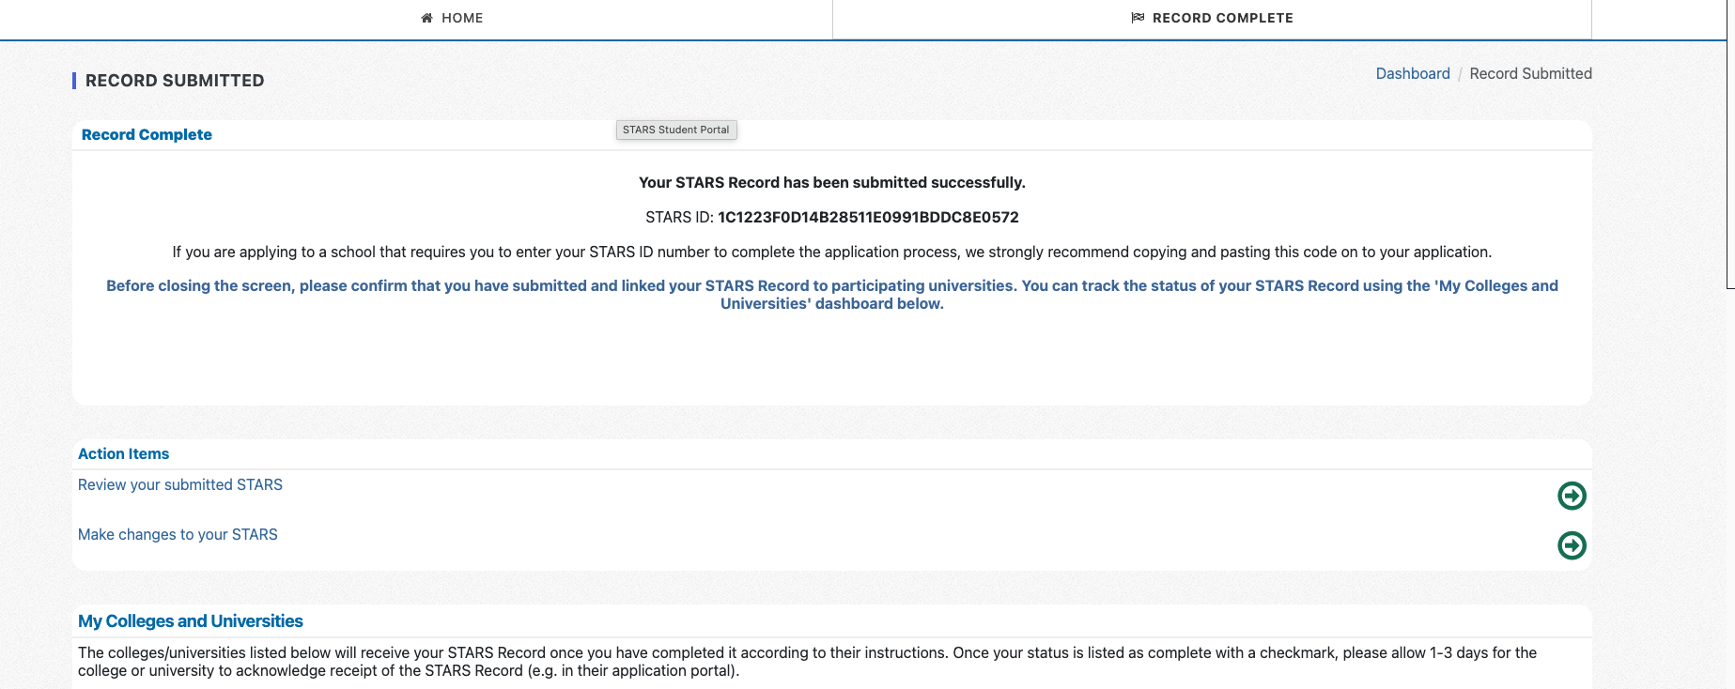
Linking to College Applications
STARS ID
Review submission
Changes window

Slide 33
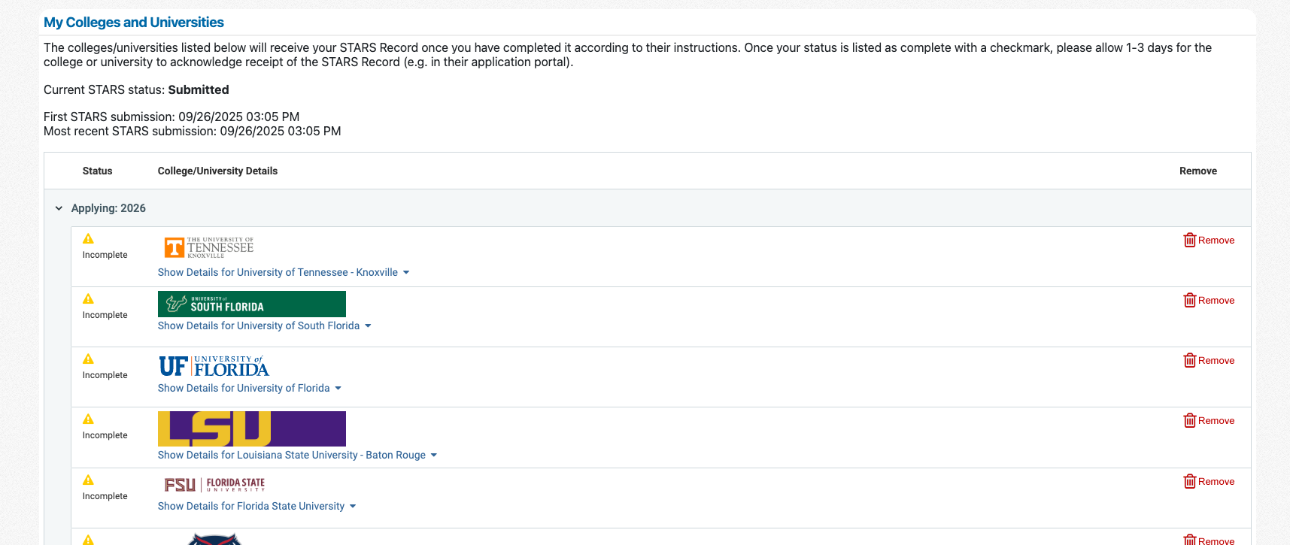
Linking to College Applications
Submission details
Linking directions per school

Slide 34
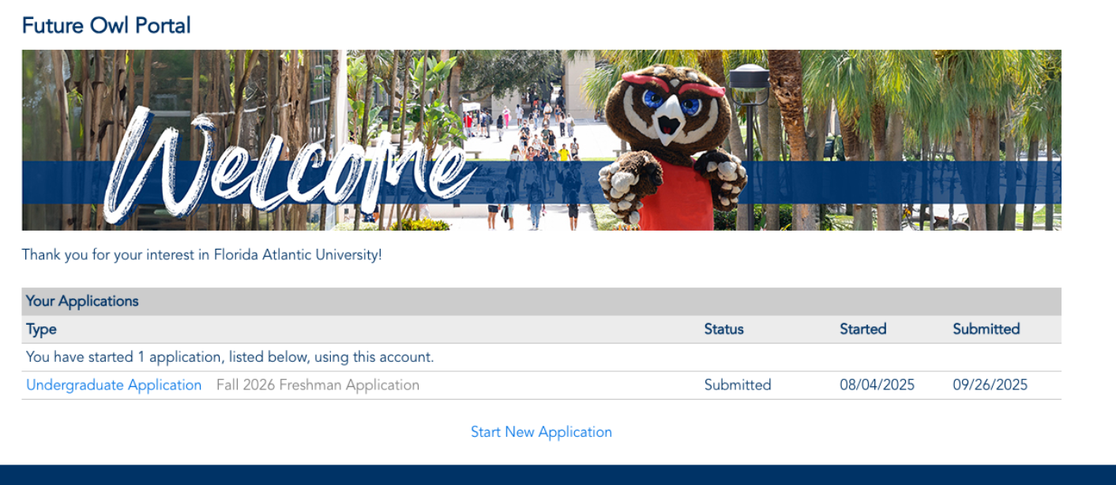
Linking - Example 1
Click

Slide 35
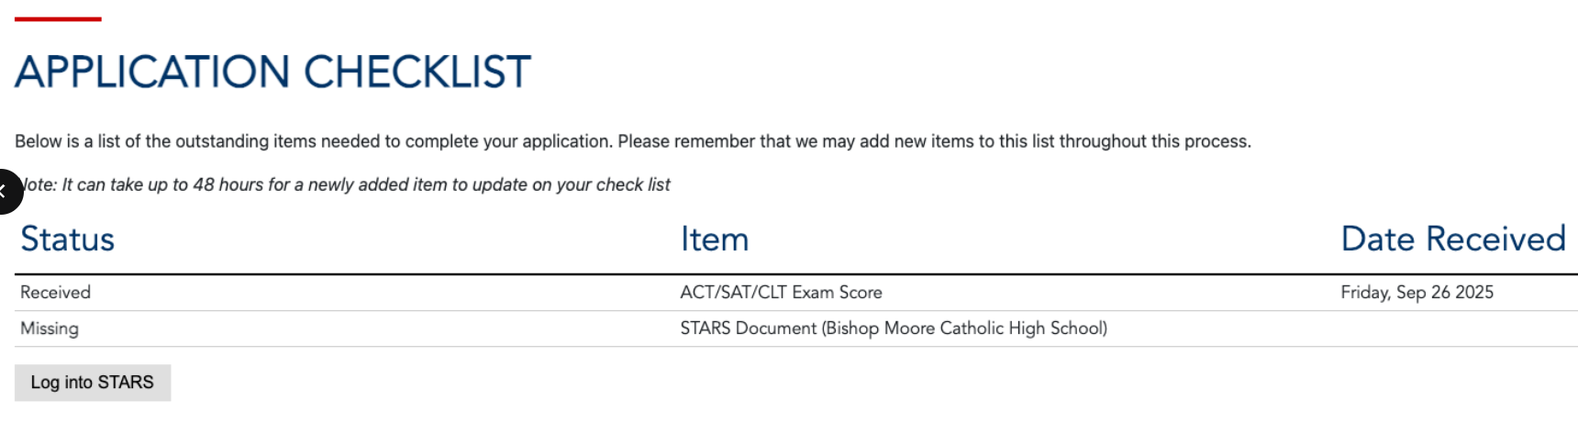
Linking - Example 1
Click

Slide 36
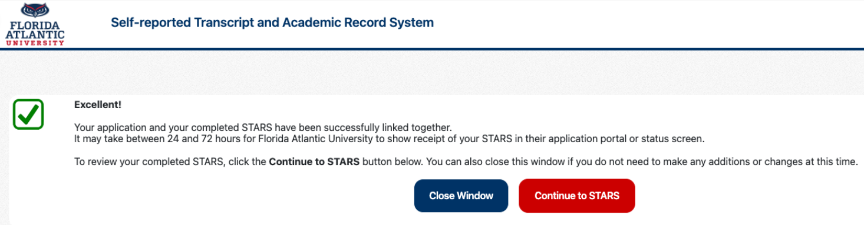
Linking - Example 1

Slide 37
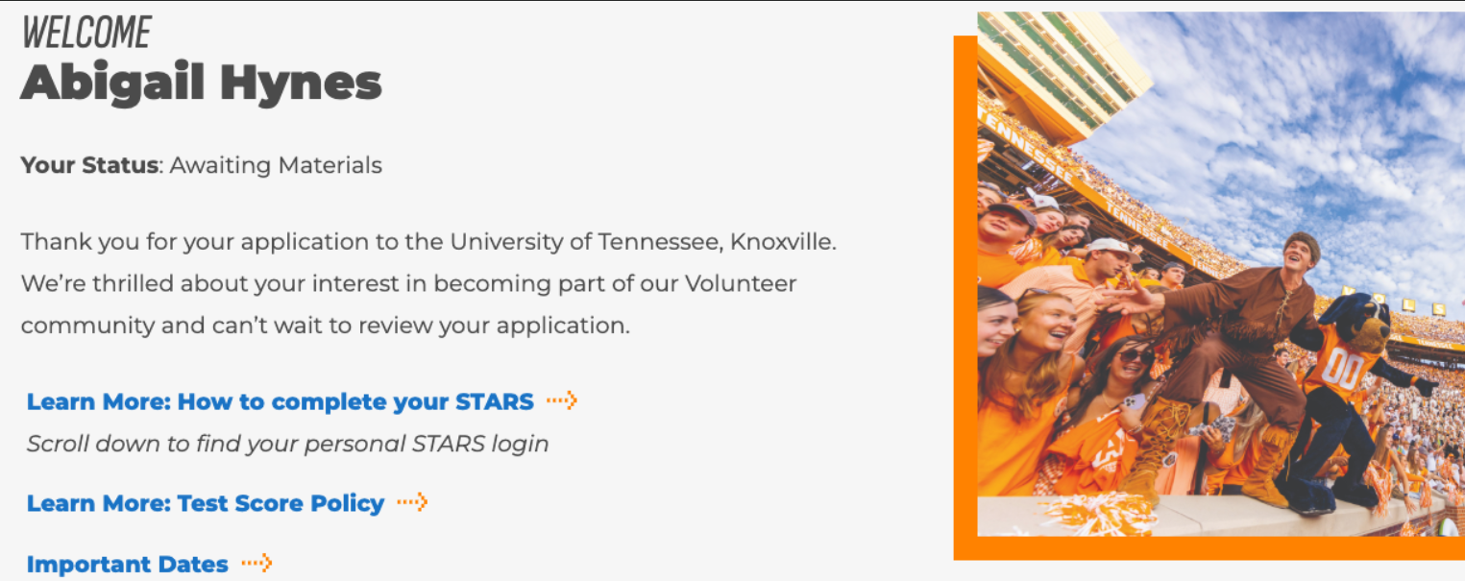
Linking - Example 2
Click

Slide 38
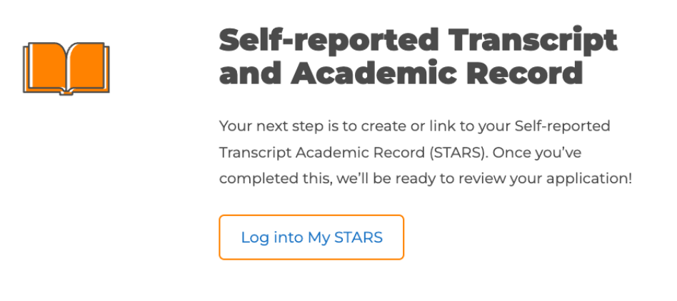
Linking - Example 2
Click

Slide 39

WORK EARLY…
but
TAKE YOUR TIME !!!

