Slide 1
College Info Night
ACT and SAT
Tom Laegeler
College & Career Counselor
Bishop Moore Catholic High School

Slide 2
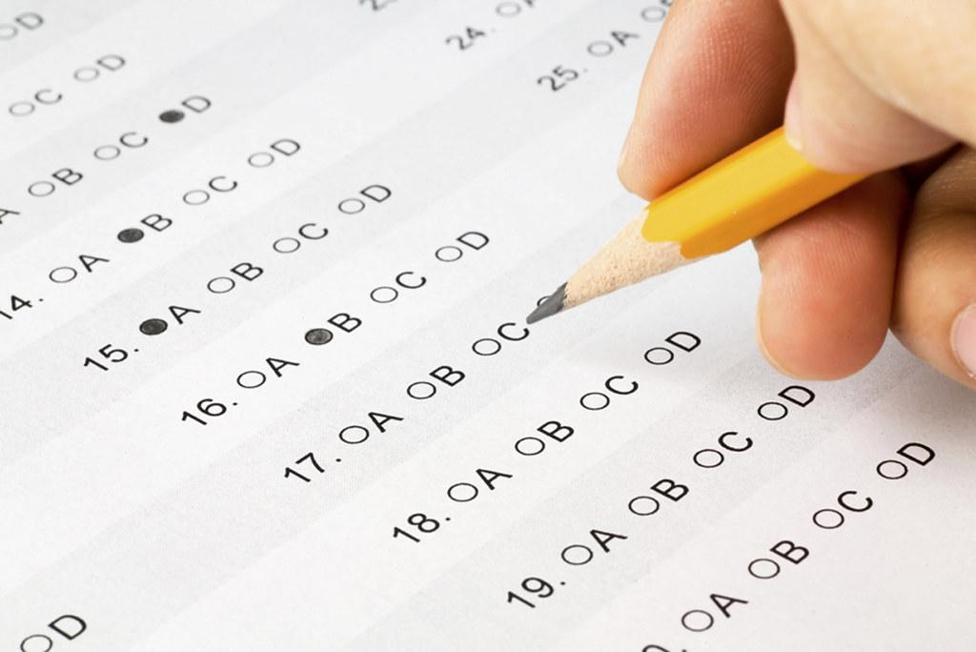
ACT & SAT -- What You Need To Know
ACT = American College Testing
SAT = Scholastic Aptitude Test
Entrance exams
PSAT/NMSQT = Preliminary SAT/ National Merit Scholarship Qualifying Test
Notes:
TWO STANDARDIZED TESTS USE TO TRACK COLLEGE PREPAREDNESS

Slide 3
ACT & SAT- Their Similarities
They both . . .
cost money (ACT, $63; SAT, $60)
have math sections that focus on algebra
take a few hours to complete and time to prepare
have no penalty for guessing
are accepted by colleges and universities
Notes:
Better to take chance and guess than to leave an answer blank

Slide 4
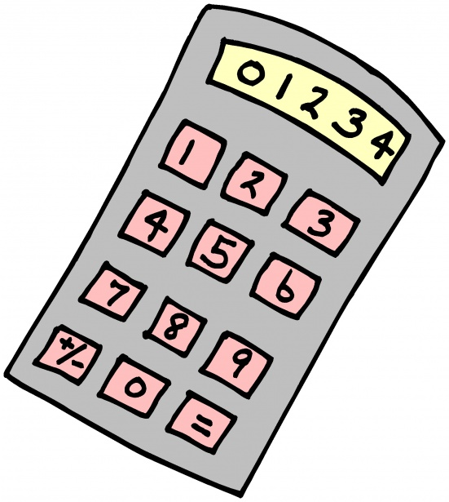
ACT & SAT- Their Differences
ACT is 2.5 hours long
sections on English, Math, Reading & Science
calculator allowed on Math
scoring: 1 - 36
SAT is 3 hours long
Qualification for National Merit Scholarships (PSAT)
sections on Reading, Writing and Language, Math with calculator & Math without calculator
scoring: 400 - 1600

Slide 5
Parts of a puzzle
Several pieces
along w/ GPA, Resume, Essays, Recs.
Optional (Is it really?)
in Florida? needed for scholarships ?
Common Criticisms
1 measure in time..
biased toward certain groups, anxiety inducing
Notes:
Puzzle is metaphor for college application process: One test, on one morning, with a bit of anxiousness. Did he sleep well? Did she know her surroundings? Did she prepare well?

Slide 6
Test Optional? For Who? What?
More and more colleges are going test optional. This is a fluid situation (can change from year to year).
All Florida SUS State University System schools require a test.
Two area schools: Stetson University and Rollins College do not.
For other test optional schools: https://fairtest.org/school/
Florida Bright Futures Scholarships: FAS and FMS DO Require a Test Score.

Slide 7
Testing plan
Pre ACT 9th/10th, Pre SAT 9th/10th/11th
Which does your student prefer (pacing and content)?
Which was higher score? Superscore?
(Concordance Table; Conversion Table)
Notes:
pacing: more time per question on SAT math; but SAT score is 50% math.
not much improvement after third attempt

Slide 8
Testing Plan
Prep before taking a second time (or 1st time)
Take a third time if close to goal
e.g., FL Bright Future: 29/1340; 25/1210
The average scores (2019): 20.8 out of 36;
1059 out of 1600
Notes:
2 to 3 weeks scores are available

Slide 9
Test Prep
Books / courses (Princeton Review, Kaplan, Magoosh)
ACT Academy - act.org
Khan Academy - collegeboard.org
Ray Dass
Local tutors
“Practice makes perfect”

Slide 10
Accommodations
Offered by both College Board (SAT) and ACT
Register 6-8 weeks before desired test date deadline
Vary by student -- diagnosis, need, use at school
For questions or applications encourage student to see Mrs. Tompkins or Mrs. Harkness

Slide 11
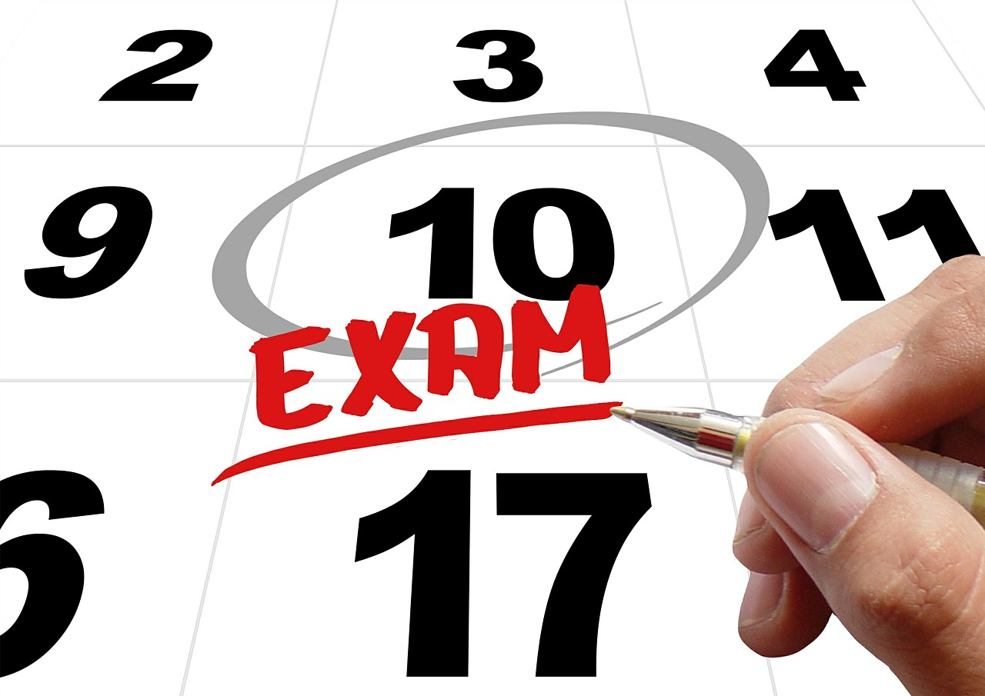
Test dates
ACT Test Dates: Spring/Summer 2023
Test Date Registration Deadline Late Regist. Deadline
$63 $36 late fee
March 9 All juniors are registered
April 15 March 10 March 24
June 10 May 5 May 19
July 15 June 16 June 23
Notes:
June test date is the last test date for seniors for Bright Futures.

Slide 12
Test dates
SAT Test Dates: Spring/Summer 2023
Test Date Registration Deadline Late Regist. Deadline
$60 test fee $30 late fee
March 11 Feb. 10 Feb. 28
*May 6 April 7 April 25
June 3 May 4 May 23
*test is offered at Bishop Moore Catholic High School
Notes:
A Fall and Spring SAT is offered at BMCHS …Dates to be announced each year.

Slide 13
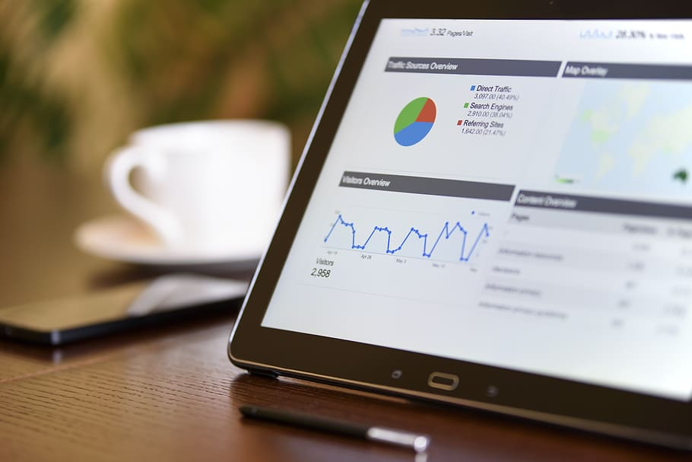
But wait, there’s more . . .
the SAT is going digital!
Available on laptop or tablet in 2024
PSAT will be digital in Fall of 2023
Notes:
Will be available digitally in 2024 for domestic students ( 2023 for international students). laptop or tablet using digital exam app that you download

Slide 14
Digital SAT: What Is Staying the Same
Still scored on 1600 scale
Still taken in schools/ test centers with proctors present (vs at home)
Still supports all students including those needing accommodations

Slide 15
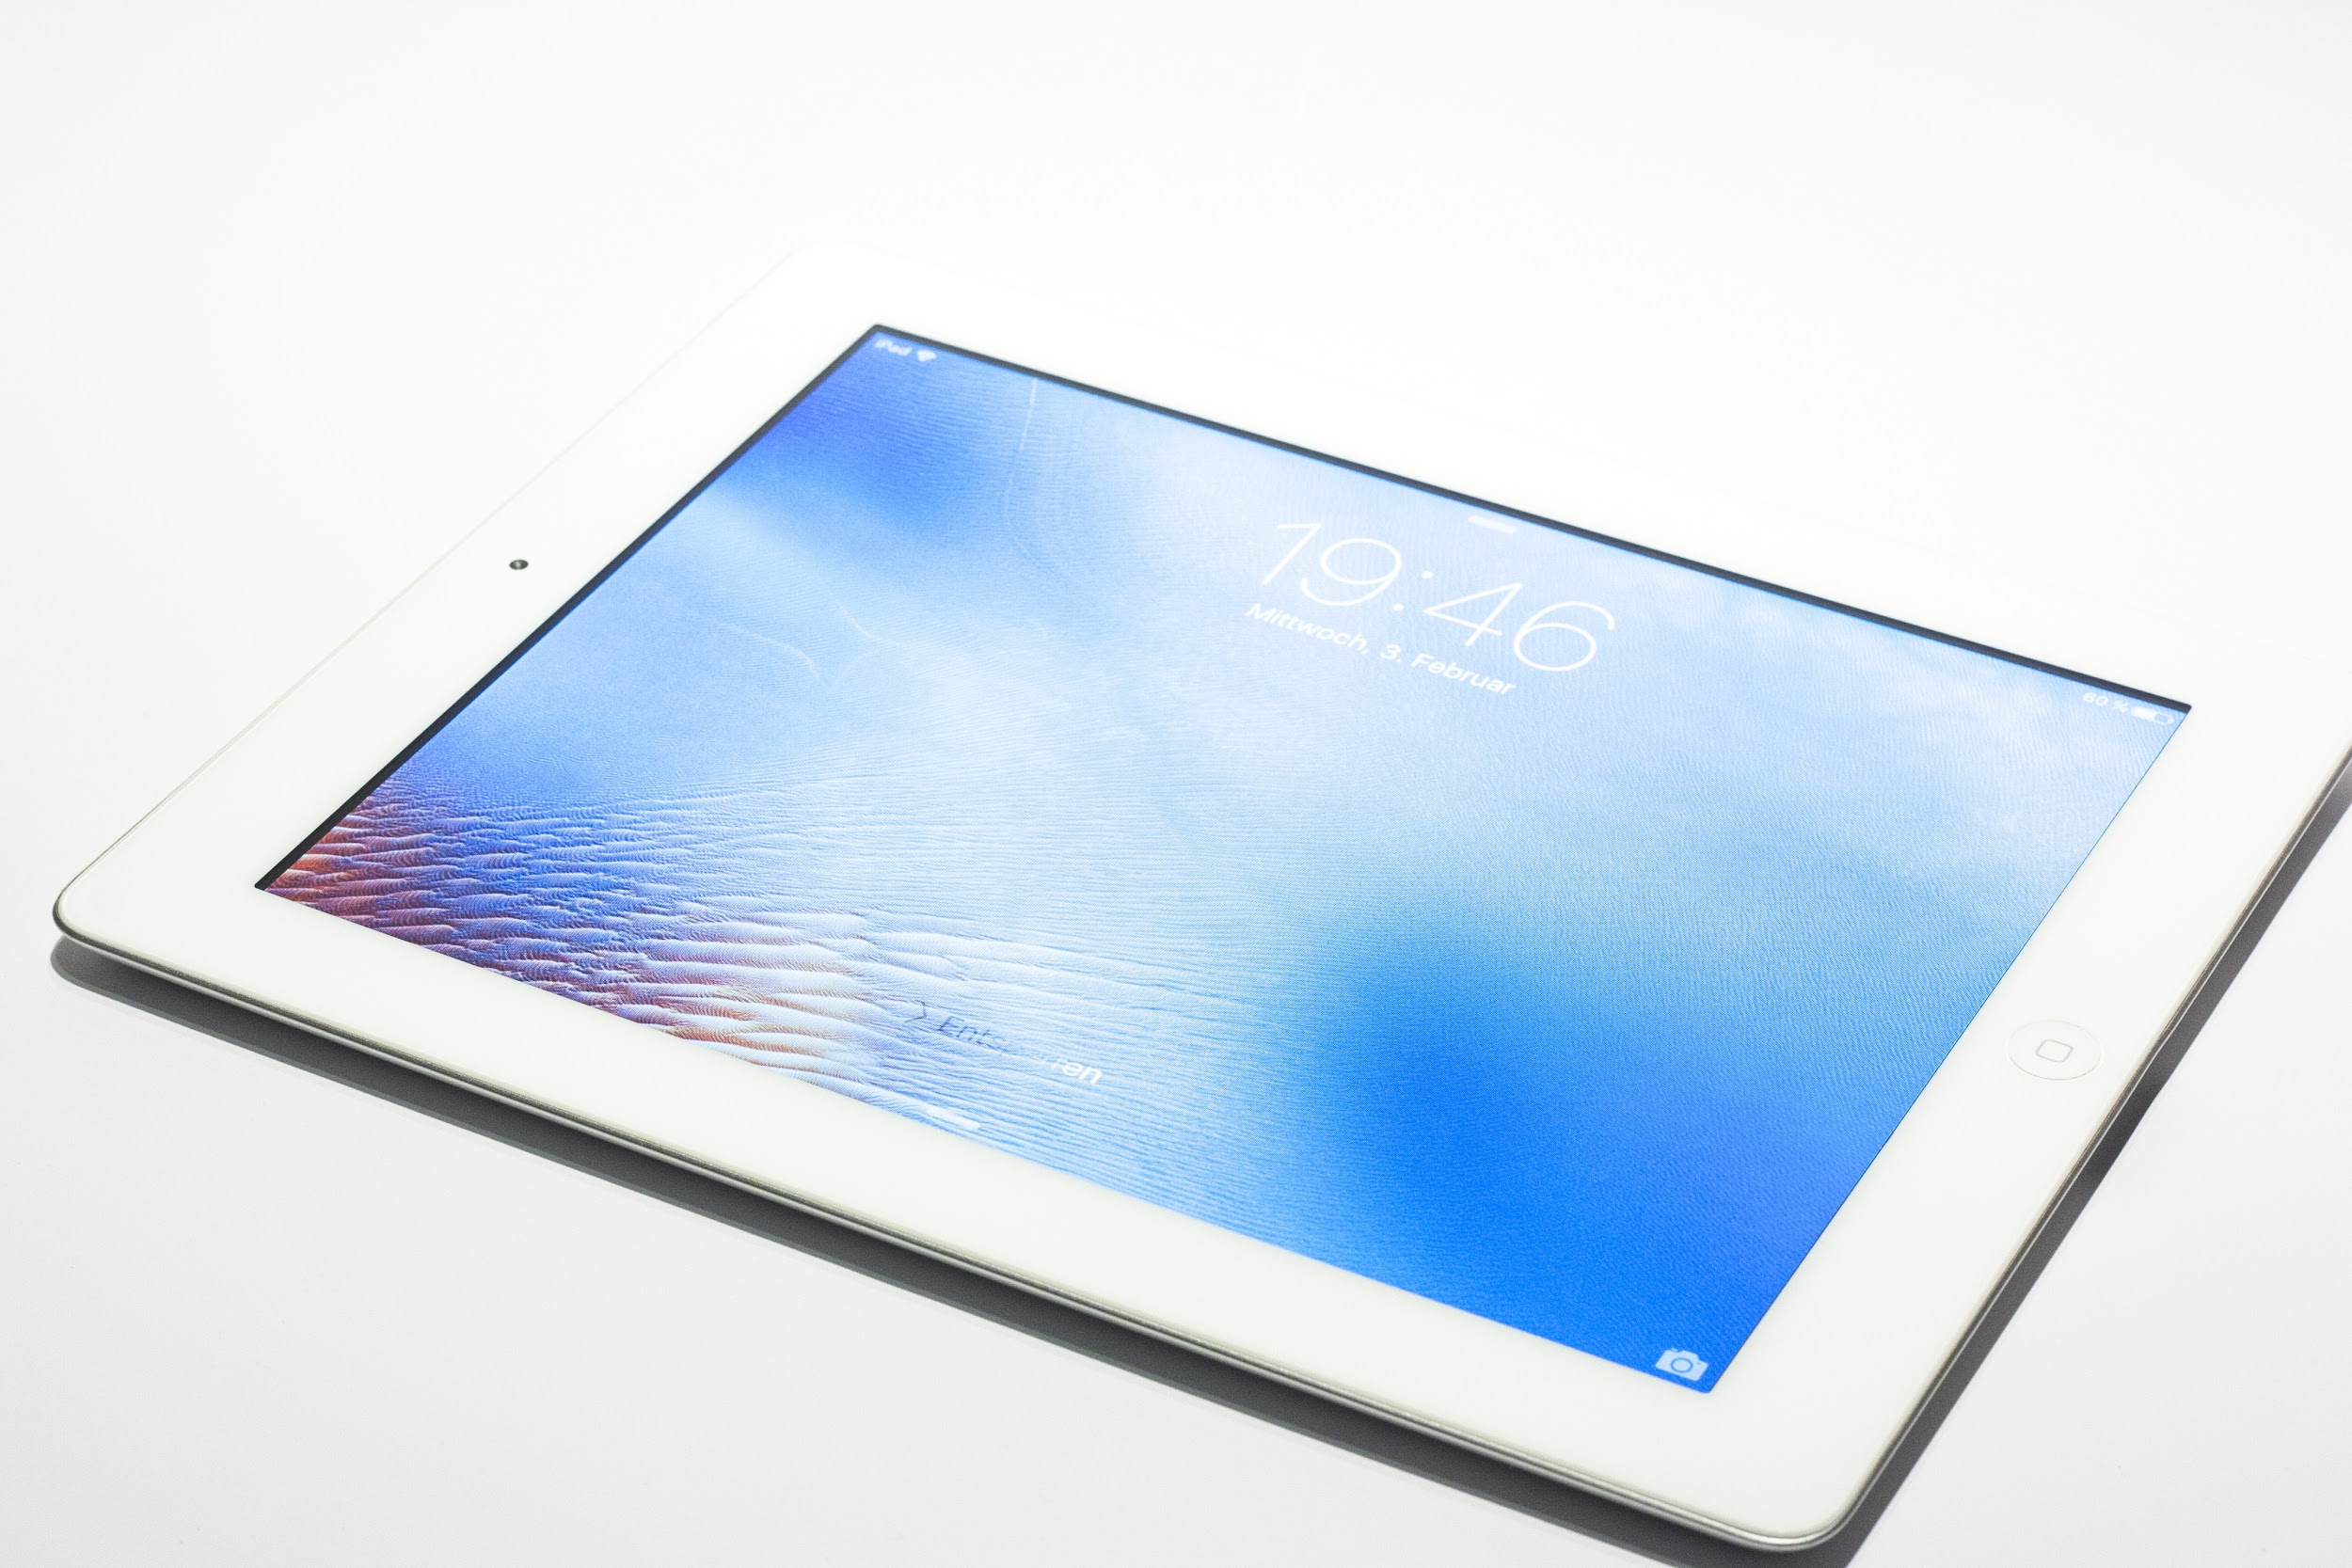
Digital SAT: What Is Changing?
Take the SAT on a laptop or tablet
Shorter test (about 2 hours)
Shorter reading passages instead of a few long texts
Can use calculator on the entire math section

Slide 16
More Specific Generalized Overview of Digital SAT
Will Operate via an App called “Bluebook” downloadable to laptops or tablets, managed devices (not phones)
Students will receive their test admission ticket through Bluebook
Bluebook is equipped to handle Wifi outages to let testing continue
Student’s device must be be able to be connected to Wifi
Device must hold a charge for 3 hours
Practice tests are available on the “Bluebook App”

Slide 17
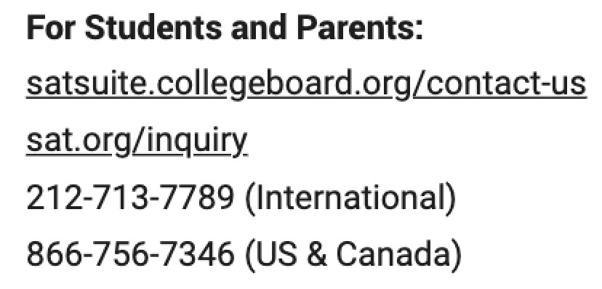
For Additional Questions related to Digital SAT
For Students and Parents:
sFor Students and Parents:
For Students and Parents:

Slide 18
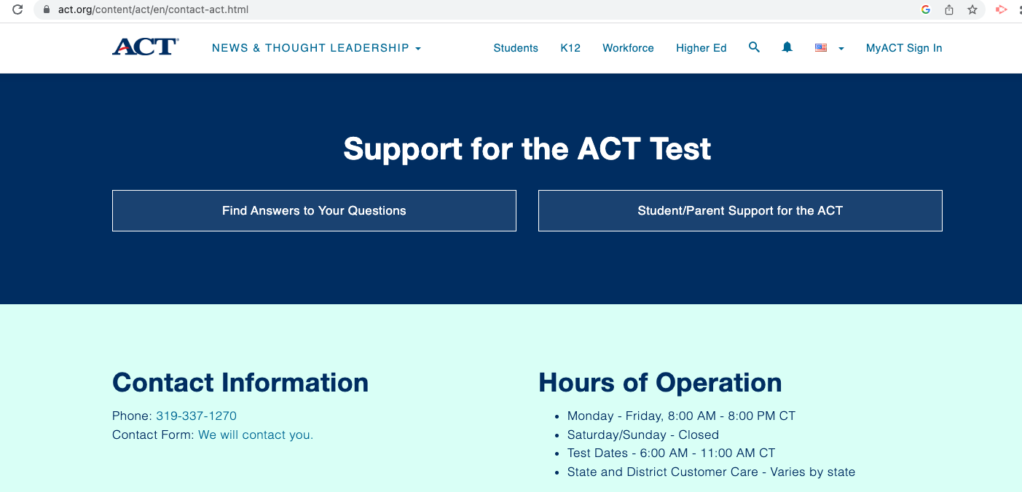
ACT Contact Information

Slide 19
Questions
?????s
Please Scan the QR code (at the bottom of your sheet)
& please fill out the evaluation.
Thanks for coming!
Notes:
NCAA send scores with code 9999; now test optional

