Slide 1
STUDENT ATHLETE COLLEGE PREPARATION
Presented by the offices of Student Success, School Counseling,
and College & Career

Slide 2
NCAA ELIGIBILITY CENTER
Student Athletes hoping to compete within the NCAA Division I or II must register with the NCAA Eligibility Center
The Eligibility Center is responsible for reviewing your Academic Initial Eligibility Requirements, as well as your Amateurism
Register for a Profile Page or a Certification account at eligibilitycenter.org
Registration fee is $90
Before you can take an Official Visit and/or sign an NLI, you must be registered
Your future school must place you on their IRL (Institutional Request List) in order for you to be certified

Slide 3
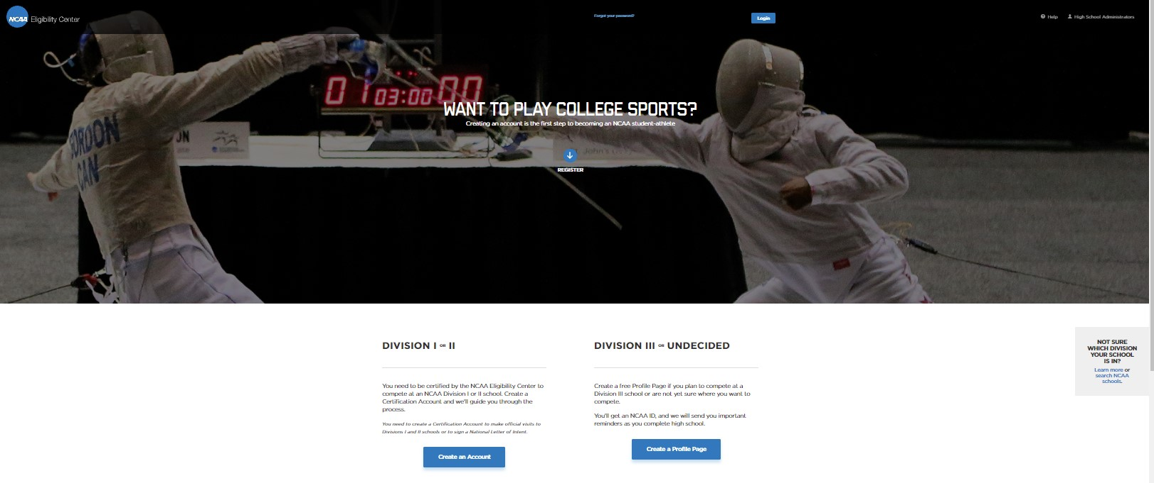

Slide 4
NCAA INITIAL ELIGIBILITY REQUIREMENTS
CORE-COURSE REQUIREMENTS
Complete 16 core courses in the following areas:
ENGLISH 4 years
MATH (Algebra I or higher) 3 years
NATURAL/ PHYSICAL SCIENCE (Including one year of lab, if offered) 2 years
SOCIAL SCIENCE 2 years
ADDITIONAL COURSES (Any area listed to the left, foreign language or comparative religion/philosophy) 4 years
Check Eligible high school courses- https://web3.ncaa.org/hsportal/exec/hsAction?hsActionSubmit=searchHighS
Ten of the 16 core courses must be completed before the seventh semester (senior year) of high school
Seven of the 10 core courses must be in English, math or natural/physical science
Earn a core-course GPA of at least 2.300
Earn an SAT combined score or ACT sum score matching the core-course GPA on the Division I sliding scale
proof of graduation

Slide 5
Standardized test scores are excluded from NCAA initial eligibility criteria for students who initially enroll full time in an NCAA school during the 2020-21, 2021-22 and/or 2022-23 academic years.
However, colleges and/or scholarship programs may still require test scores.
BMC will submit your Official Transcript to NCAA/NAIA upon request
You are responsible for sending your SAT/ACT Scores (college code 9999)

Slide 6
NCAA – NAME, IMAGE, & LIKENESS (NIL)
NCAA student-athletes now have the opportunity to benefit from their name, image and likeness
All three divisions have adopted a uniform, interim policy suspending NCAA NIL rules for all incoming and current student-athletes in all sports
For more NIL resources: Visit ncaa.org/nil

Slide 7
NAIA
Typically Smaller Colleges- 250 institutions
Emerging sports such as bowling, lacrosse, and Women’s wrestling
No communication restrictions between coaches and high school athletes
Student Athletes hoping to compete within the NAIA must register with the NAIA Eligibility Center
Register for a Certification account at play.myNAIA.org
Registration fee is $90
Early Decision is available for students who meet the following criteria:
Test Score 18+ ACT or 970+ SAT (NAIA test score code: 9876)
GPA 3.0+ after Junior Year or 2.5+ midway through Senior Year or 2.0 for graduates

Slide 8
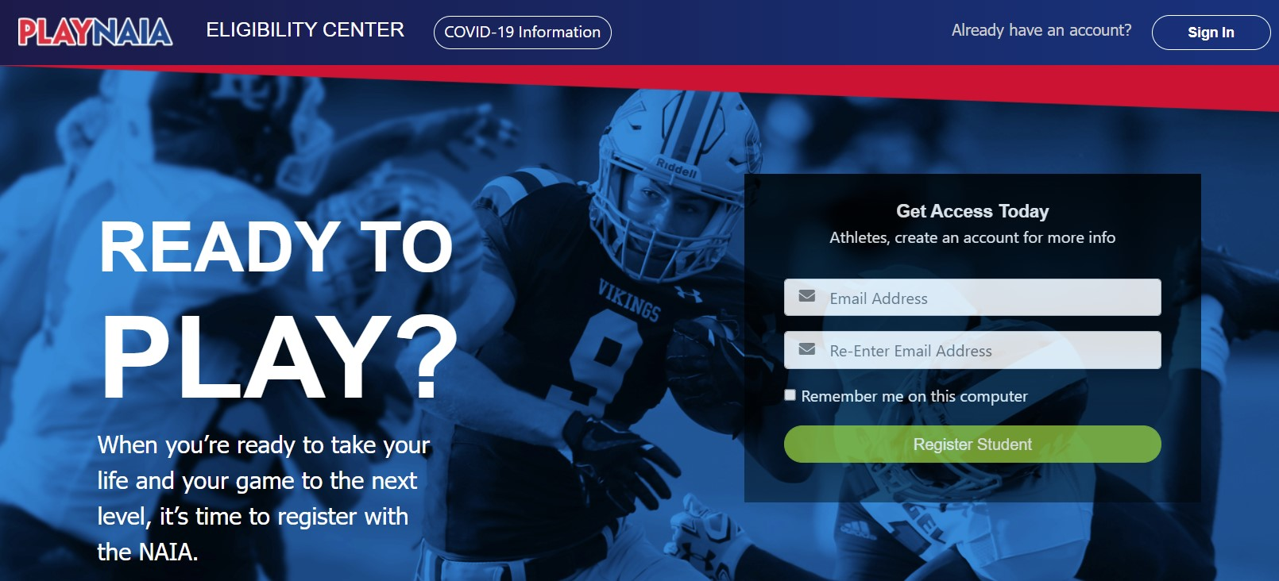

Slide 9
JUCO - 2 year colleges
Each institution decides if they want to compete at Div 1 or 2
Can receive full athletic scholarships for Div 1
May receive more athletic scholarships than if attending NCAA Div 1 or 2
Can be great stepping stone to 4-year colleges
Good for students who:
Need more time to Develop as a student
Need more time to Develop as an athlete- may have better prospects after attending JUCO
Not sure what they want to study
Want more immediate playing time
Financial circumstances make it difficult to afford a 4-year college
If non-Qualifier for NCAA, can still compete immediately at a JUCO

Slide 10
General Recruiting Advice
Market yourself
Make list of college programs you may be interested in
Emails should come from you, not parent
Highlight film
Coaches may not be able to respond until June 1 of your junior year
complete recruiting profiles
Coaches are always watching
Attitude
Sportsmanship (on the bench behavior)
Parents’ behavior
social media

Slide 11
General Recruiting Advice
Visiting Colleges
Unofficial Visits
Take advantage of visiting colleges you are interested in
If Junior or older, can reach out to athletics
Official Visits
Paid for by the college during Junior or Senior year
Division 1- limited to 5
Don’t Burn Bridges
Don’t discount any offers
Be sure to respond to emails, text messages and phone calls

Slide 12
The importance of grades & scores
Coaches ask to see your transcript
Aim for grades/test scores to admit to ideal college
Still need test scores for college
Admissions
Scholarships
Notes:
Grades do make a difference.
Coaches hes can support your application with strong grades; you become more competitive.
Strive to be admitted on your academic merits---makes process easier.
many colleges still wan

Slide 13
Apply to range of colleges
Need to apply to colleges that you are verbally committed to
Apply to back-up schools, in case you end up not playing
Don’t commit to colleges that don’t have your major or that you don’t want to attend
Prioritize your college list

Slide 15
Types of scholarships
Still complete Bright Futures application
Most sports do not receive full “headcount” scholarships
The better grades/test scores you have the better chances of other (academic) scholarships
Although Div 3 cannot offer athletic scholarships, you potentially could get more scholarships than from D1 or D2 schools

